Slide 1

Sources of Capital
This presentation explores various sources of startup financing, including personal funds, family and friends, commercial banks, and angel investors, providing insights for aspiring entrepreneurs.
Week 12 – MGMT 420

Slide 2
Startup Thought Experiment: Where to Find Funds
EXPLORING INITIAL CAPITAL SOURCES FOR ENTREPRENEURS
Imagine launching your business tomorrow. Consider where you would secure your first $10,000: personal savings, family loans, or perhaps small investors. Exploring these options is crucial.

Slide 3
Internal vs. External Funding Sources
INTERNAL FUNDING
EXTERNAL FUNDING
CONTROL VS. LEVERAGE
Internal funding includes personal savings, retained earnings, and supplier terms. This control-driven approach allows entrepreneurs to maintain decision-making authority and reduce reliance on outside sources.
External funding encompasses loans, investors, and grants. While it offers growth potential, this approach often involves sharing control and decision-making, which may dilute the entrepreneur's authority.
Choosing between internal and external funding requires careful consideration of control versus leverage. Entrepreneurs must balance their desire for ownership with the need for capital to fuel growth.

Slide 4

Personal Funds
Exploring the concept of “blood equity” in startups
Personal funds encompass savings, retirement accounts, and asset liquidation, demonstrating the entrepreneur's commitment and confidence in their venture, which can attract further investments.

Slide 5



Family Funding
Funding from family and friends can be a quick and accessible option, but it carries significant emotional and financial risks, making transparency and written agreements essential for all parties involved.

Slide 6

Commercial Bank Loans
Understanding formal lending options
  Banks provide short- and long-term financing.
  Key factors in lending: Character, Capacity, Capital, Collateral, Conditions.
  For example, a $100,000 equipment loan requires 80% collateral.

Slide 7
R&D Limited Partnerships
INVESTOR COLLABORATION
In R&D limited partnerships, investors collaborate with sponsoring companies to fund innovative projects. This partnership model fosters resources sharing and enhances opportunities for groundbreaking research.
CONTRACTUAL AGREEMENTS
The contract defines the terms of the partnership, including research objectives and profit-sharing percentages. These agreements ensure clarity and mitigate potential disputes between partners throughout the project.
RISK AND TAX BENEFITS
Limited partnerships offer shared risk among partners, reducing individual financial exposure. Additionally, they provide potential tax advantages for both investors and companies, enhancing overall project feasibility.

Slide 8
Government Grants for Small Businesses
SBIR PROGRAM
STTR PROGRAM
FEDERAL FUNDING SOURCES
The Small Business Innovation Research (SBIR) program provides crucial funding to support innovative small businesses in the early stages of product development and commercialization.
The Small Business Technology Transfer (STTR) program requires collaboration with research institutions, promoting joint ventures that leverage academic resources for small business innovations and technology advancements.
Both SBIR and STTR programs are funded by federal agencies, including NASA, NSF, DOE, and NIH, ensuring competitive grants that drive innovation and economic growth within the small business sector.

Slide 9
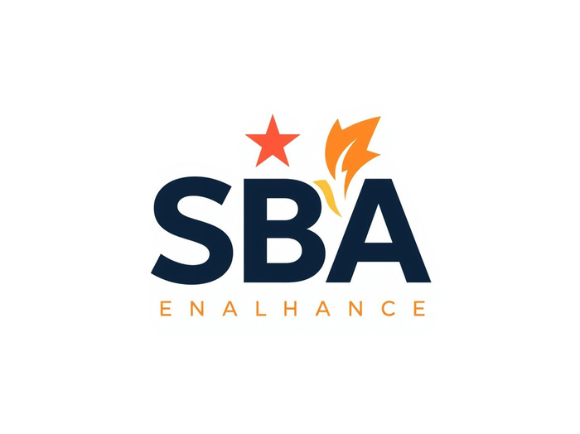





Other Government Grants
SBA GROWTH
USDA RBDG
DOE ARPA-E
Government support
Agricultural funding
Energy innovation
EDA FUNDING
MBDA SUPPORT
NIH RESEARCH
Economic growth
Minority businesses
Health innovation

Slide 10


Angels and Private Offerings
Understanding the role of angel investors in startups
Angel investors play a critical role in funding early-stage ventures, offering both capital and mentorship to help startups thrive and grow.

Slide 11

Bootstrap Financing
Creative and resourceful ways to fund your venture
Bootstrap financing involves leveraging creativity and savings to grow your business while retaining full ownership and control, effectively avoiding dilution and outside investors.

Slide 12
Reflection on Capital Sources
BEST FIT
Identifying the ideal funding source tailored to your business model is crucial for success. Consider the resources available and align them with your venture’s growth objectives.
TRADE-OFFS
Every capital source presents trade-offs between control and risk. Analyze how each option impacts ownership, decision-making authority, and long-term financial stability for your startup.
FUTURE STRATEGY
Your funding decisions will significantly shape your business strategy. Ensure that the chosen source supports not only immediate needs but also aligns with your vision for future growth.

