Slide 1


Business Growth
Strategies for Growth
Week 13 – Chapter 14
MGMT 420

Slide 2

Opportunities for Growth
Growth opportunities emerge after entrepreneurial success, allowing businesses to explore market penetration, product development, market development, and diversification strategies for sustainable expansion.

Slide 3

Penetration Strategy
Market share increase
An increase in market share can be achieved through targeted penetration strategies, emphasizing existing products and enhancing customer engagement to boost sales and frequency of use.

Slide 4

Market Development Strategies
Market development strategies focus on expanding to new customer segments while leveraging existing products. This approach can significantly enhance business reach and profitability.

Slide 5


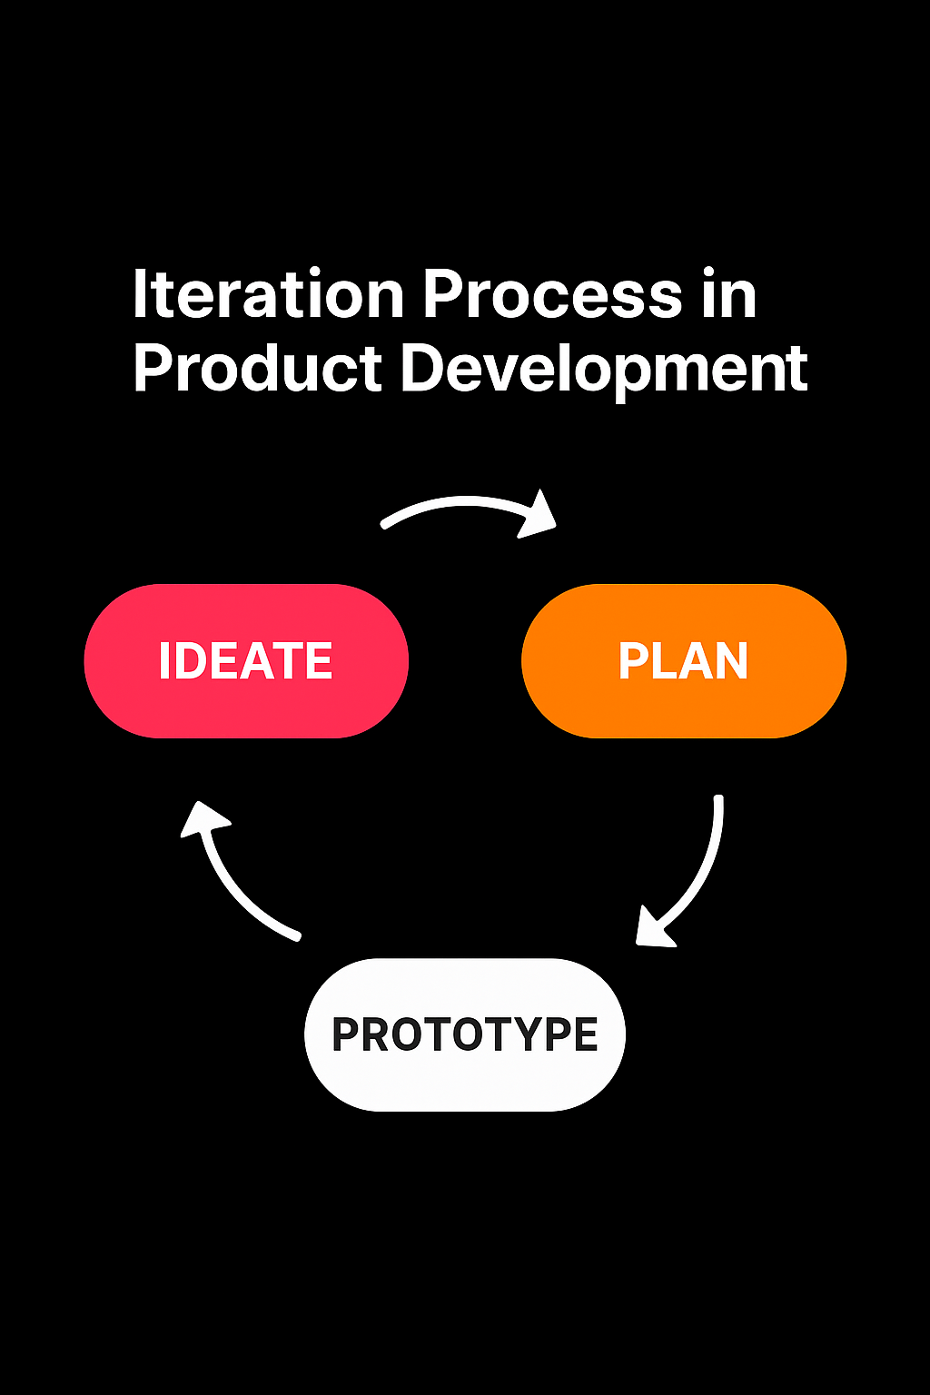
Product Development Strategies
NEW PRODUCT LAUNCH
Innovative design
CUSTOMER FEEDBACK
User insights
ITERATION PROCESS
Continuous improvement

Slide 6
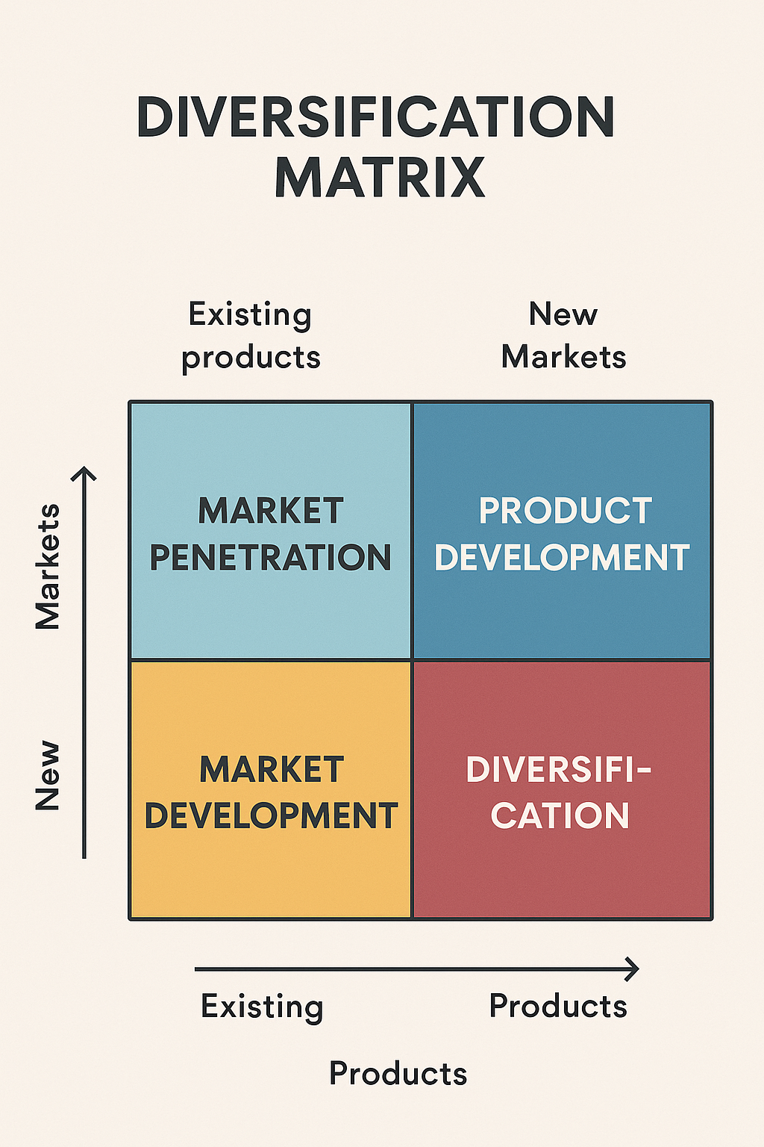
Diversification Strategies
Diversification involves expanding into new markets with new products, balancing risk and opportunity to enhance business resilience and capitalize on emerging trends in various segments.

Slide 7

Growth Essentials
“Growth requires delegation, structure, and discipline.”
– HISRICH

Slide 8



Overcoming HR Pressures
TEAM COLLABORATION
Unity in action
PROFESSIONAL DEVELOPMENT
Skill enhancement
CULTURAL AMBASSADORS
Role model
Notes:
The HR strategy must maintain corporate culture despite bringing in new employees.
The entrepreneur must be the role model but in cases of rapid growth, they may need a cultural ambassador.
Most new ventures do not have an HR department but can use professional employer organizations.
A key decision is the correct proportion of part-time or freelance employees.
A difficult decision is firing an incompetent employee.

Slide 9

Overcoming Management Pressures
Effective management during growth requires a participative decision-making approach that encourages team involvement, fosters motivation, and reduces information overload while ensuring clarity in roles and responsibilities.
Notes:
Managing change is complex and requires a participative style of management involving others in decision making.
Advantages of this management style.
It reduces information-processing demands on the entrepreneur.
Qualified employees find new ways to tackle current problems.
Involved employees are more motivated to implement the decision.
It enhances job satisfaction.
Activities to institute participative management.
Establish a team spirit, communicate, and provide feedback.
Delegate some responsibility to others.
Provide continuous training for employees.

Slide 10

Overcoming Time Pressures
Time management is crucial for effective growth. By applying strategies like prioritization and delegation, entrepreneurs can enhance productivity while maintaining a balanced approach to their responsibilities.
Notes:
The entrepreneur benefits from practicing time management.
Increased productivity and job satisfaction, quality relationships, improved decision-making, and ultimately better health.
The basic principles of time management.
The principle of desire requires recognition of wasted time.
The principle of effectiveness requires focus under pressure.
The principle of analysis shows how time is currently allocated.
The principle of teamwork acknowledges importance of delegation.
The principle of prioritized planning allocates time by category.
The principle of reanalysis requires review of time management.

Slide 11



Overcoming Financial Pressures
CASH FLOW MANAGEMENT
Streamlined process
BUDGET FORECASTING
Financial planning
COST CONTROL
Expense management
Notes:
Reduce the need for new financial resources by better managing existing resources.
The entrepreneur must know how to provide financial controls to ensure pro forma projections and goals are met.
Some financial skills are needed to manage during the early years.
The cash flows, income statement, and balance sheet are key areas needing careful management and control.
The entrepreneur must manage cash flows, inventory, fixed assets, costs and profits, and taxes.

Slide 12



Managing Cash Flow and Assets
CASH FLOW ARROWS
Flow management
INVENTORY SYSTEM
Stock control
ASSET MANAGEMENT
Resource allocation
Notes:
A monthly cash flow statement shows actual amounts next to budgeted amounts—useful in adjusting pro forma statements.
Sensitivity analysis may be involved.
A daily cash sheet may be needed by a very new venture.
Comparison of budgeted to actual cash flows indicate daily shortfalls, problems in managing assets and cost control.

Slide 13

Entrepreneurial Mindset
Embracing a growth mindset is crucial for entrepreneurs. This adaptability fosters innovation and resilience, allowing businesses to thrive in dynamic environments.
Notes:
Some entrepreneurs lack ability to transition to a more professional management style.
Others may be able but unwilling to focus on growth.
Some entrepreneurs do not pursue growth as they believe it sacrifices profitability and chance of survival.
Others avoid growth so as not to yield equity or incur debt.

