Slide 1


Identifying & Analyzing Opportunities
Entrepreneurship in Domestic and Global Contexts
Presented by: [Your Name]

Slide 2

Chapter 5 Overview
Understanding how to evaluate opportunities for business success
Assessing opportunity viability is essential for entrepreneurial success in today's markets.

Slide 3

Globalization Redefines Business Boundaries
Globalization is transforming how we view opportunities, erasing traditional distinctions between domestic and international markets. Entrepreneurs must embrace a borderless mindset to leverage global connections for growth and innovation.

Slide 4
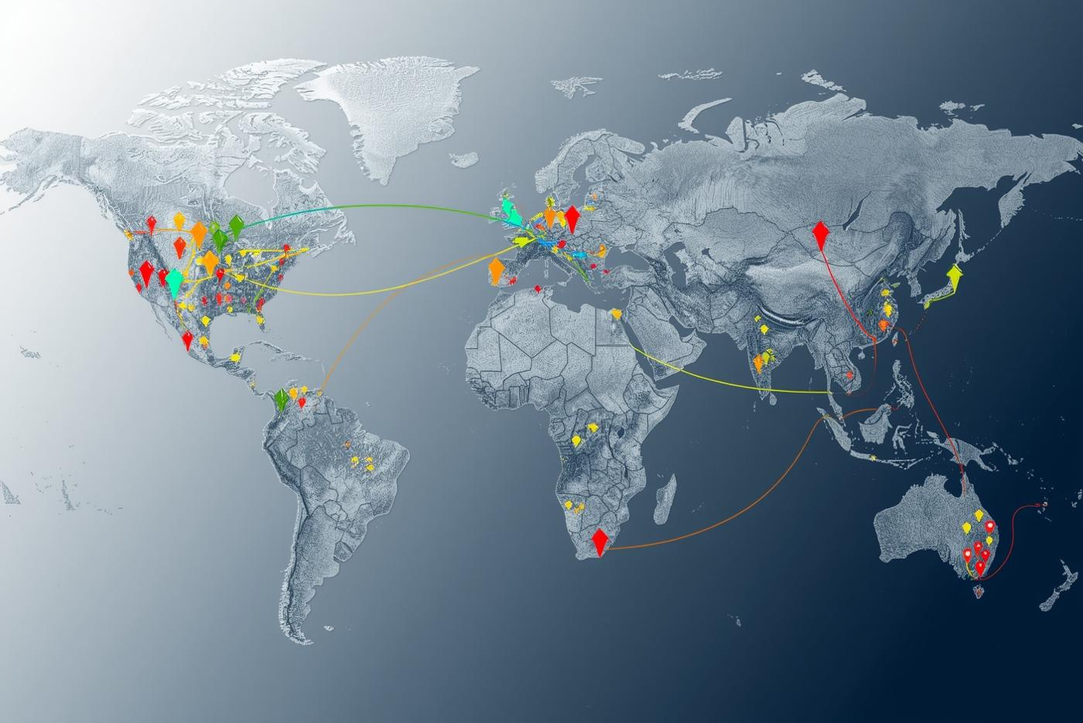
Global Opportunities Emerge
01
Blurred Opportunity Lines
Globalization creates overlap between domestic and international opportunities, making traditional boundaries less relevant.
02
Global Customer Base
Entrepreneurs must consider a worldwide audience, as customers can now be reached from anywhere.
03
Digital Channels
Technology and e-commerce have fundamentally changed accessibility, allowing businesses to operate across geographic boundaries.

Slide 5
E-commerce Global Opportunities
01
Simplified Payment Processing
Online platforms streamline payment solutions, allowing entrepreneurs to easily accept transactions from global customers without significant barriers.
02
Efficient Logistics and Shipping
Integrated logistics services enable faster and more reliable shipping options, enhancing customer satisfaction and supporting international growth.
03
Rapid Market Testing
E-commerce platforms allow businesses to quickly test product demand in multiple markets, minimizing risks before significant investments are made.

Slide 6

Opportunity Assessment Plan
A quick and effective tool for evaluating business ideas
This plan focuses on opportunity viability before developing a full business plan.

Slide 7


Product & Market Need
Visualizing the critical clean-water solution

Slide 8


Personal Fit & Launch
Illustrating readiness and execution pathways

Slide 9

Why International Business Matters
Understanding the importance of global entrepreneurship in today's economy
Global expansion drives growth, offers new markets, and enhances competitiveness.

Slide 10
PEST Analysis Framework
01
Political Factors
Political stability, regulations, and government policies directly influence market opportunities and risks for businesses.
02
Economic Conditions and Trends
Economic indicators such as inflation, exchange rates, and consumer spending patterns affect market viability and investment decisions.
03
Social and Cultural
Social norms, demographics, and cultural factors shape consumer behavior and market preferences in different regions.
04
Technology
The availability and adoption of technology factors like internet access, digital infrastructure, automation, and innovation, which influence how efficiently a business can operate and how customers discover, buy, and use products in a market.

Slide 11
Culture Shapes Business
01
Cultural Influence on Marketing
Culture affects how brands communicate value and engage customers through tailored marketing strategies.
02
Negotiation Styles and Practices
Understanding local negotiation customs is key to building trust and closing deals successfully.
03
Packaging and Presentation
Cultural preferences dictate product packaging, influencing consumer perception and purchase decisions significantly.

Slide 12

Evaluating Distribution Systems
01
Cost Considerations
Analyze tariffs, shipping costs, and local taxes to forecast the total expenses associated with distribution.
02
Local Competition
Assess existing local competitors and their distribution efficacy to identify gaps and opportunities in the market.
03
Infrastructure Evaluation
Review transportation networks and tech adoption to ensure reliable and timely delivery to customers.

Slide 13

Motivations for Global Expansion
01
Increase Profits
Expanding globally opens new markets, increasing customer base and revenue opportunities for businesses.
02
Avoid Market Saturation
Global expansion allows companies to navigate saturated domestic markets and seek growth in emerging economies.
03
Access New Customers
Engaging with diverse cultures enables brands to tap into unique customer preferences and behaviors.

Slide 14
McDonald’s
Case Study
McDonald’s Global Strategy
  Situation: McDonald’s scaled a proven U.S. model, then expanded internationally starting in 1967 (early entries included Canada and Puerto Rico).
  Core strategy: Keep the same operational system (speed, consistency, quality standards) so customers know what to expect anywhere.
  Localization: Adapt menu items and marketing to match local tastes, culture, and dietary norms.
  Execution approach: Expand market-by-market, learn quickly, then replicate what works.
  Operations & supply chain: Develop local sourcing and distribution so stores can operate reliably and at scale.
  Resulting advantage: McDonald’s succeeded globally by balancing standardization (brand + systems) with localization (customer fit).

Slide 15
Choose Indicators
Gather Data
Identify relevant market size and growth indicators.
Collect quantitative and qualitative information for analysis.
Weight Indicators
Analyze & Validate
Assign importance to each indicator based on relevance.
Review findings to confirm the best market options.

Slide 16
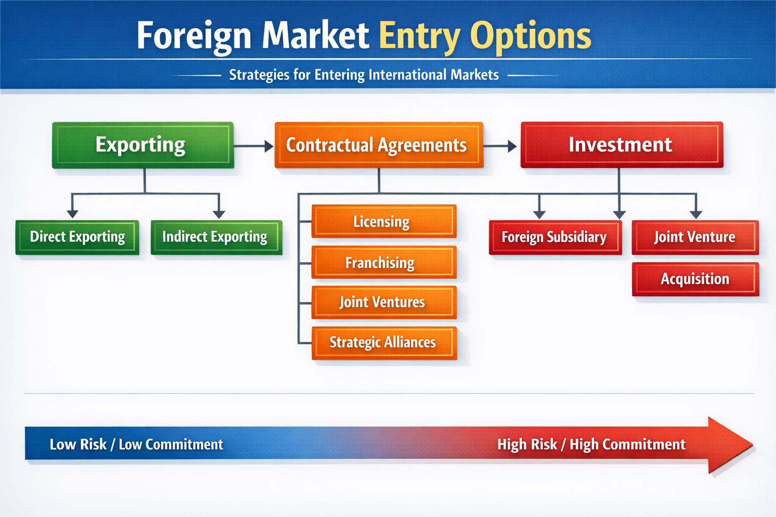
Foreign Market Entry Options
01
Exporting Options
Exporting involves selling products directly across borders, minimizing initial investment and risk exposure.
02
Licensing Agreements
Licensing allows foreign partners to produce or sell products using your brand, offering revenue with less control.
03
Direct Investment
Direct investment means establishing operations abroad, providing complete control but requiring significant resources and risk.

Slide 17

Trade Barriers
Understanding the complexities of global trade and their implications
Trade barriers can significantly impact global strategy, affecting costs and market access.

Slide 18
Trade Barriers
  Tariffs (import taxes): Extra cost added to imported goods.
  Import quotas: Limits on how much of a product can be imported.
  Embargoes/sanctions: Partial or total bans on trade with certain countries or firms.
  Licensing requirements: Needing special permits/approvals to import or sell.
  Customs delays & red tape: Slow inspections, paperwork, port congestion, administrative hurdles.
  Product standards & regulations: Different safety, labeling, testing, or quality rules by country.
  Local content requirements: A percentage of parts/labor must be sourced locally.
  Anti-dumping duties: Extra tariffs if a country claims products are sold “below fair value.”
  Subsidies to domestic firms: Government support that makes local competitors cheaper/stronger.
  Government procurement restrictions: “Buy local” rules that block foreign suppliers from contracts.
  Currency controls: Limits on exchanging currency or sending profits out of the country.
  Rules of origin: Requirements to prove where a product was made to qualify for lower tariffs under trade agreements.
Examples of Global Trade Barries to Consider

Slide 19
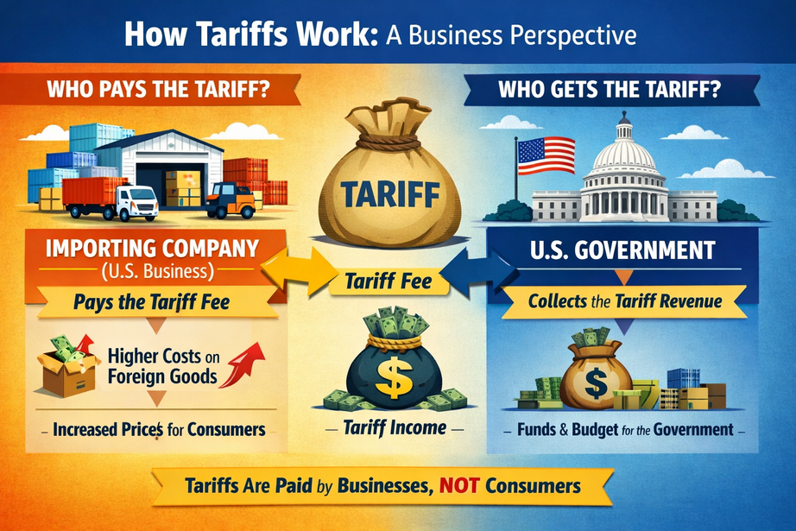
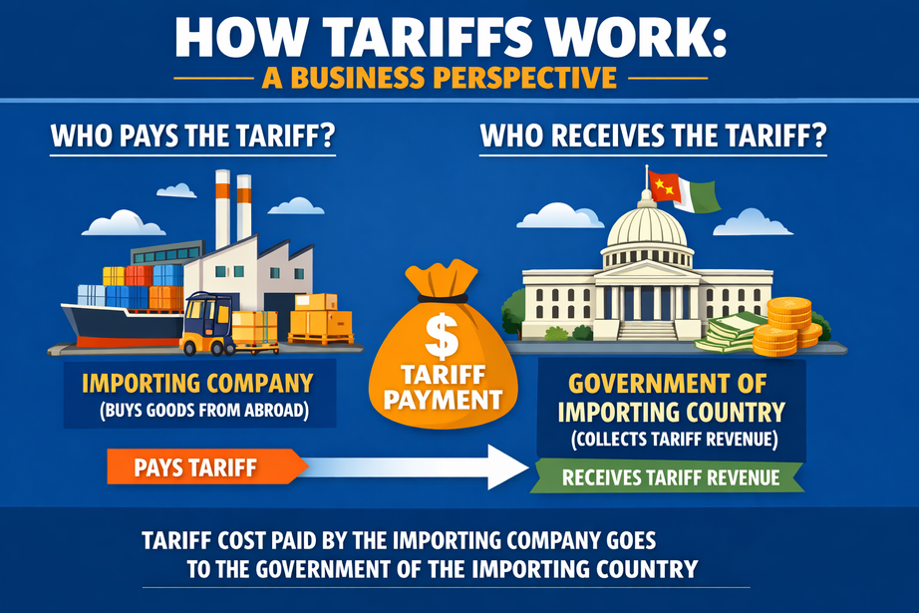
Tarrifs
A tariff is basically a tax a government puts on imported products.
From a business perspective, here’s how it works:
  A company buys a product (or parts) from another country.
  When that shipment enters the country, the government charges a tariff (a fee based on the item’s value or per unit).
  The importer has to pay that extra cost, which makes the product more expensive.
What businesses usually do next:
  Raise prices (customers pay more)
  Absorb the cost (the company pays it, profits drop)
  Switch suppliers (buy from a different country or from local producers)
  Move production (make/assemble the product locally to avoid the tariff)
Why it matters:
Tariffs can change whether a product is profitable, how a company prices it, and even where it chooses to manufacture.

