Slide 1

The Business Plan
Dr. Kheng - MGMT 420
BUSINESS STRATEGIST

Slide 2

What’s a Business Plan?
A comprehensive guide integrating essential elements for new ventures
A business plan is a written document that outlines both internal and external aspects of a new venture. It integrates critical components such as marketing, operations, finance, and personnel plans, effectively acting as a roadmap for the first three years, guiding entrepreneurs through their startup journey.

Slide 3
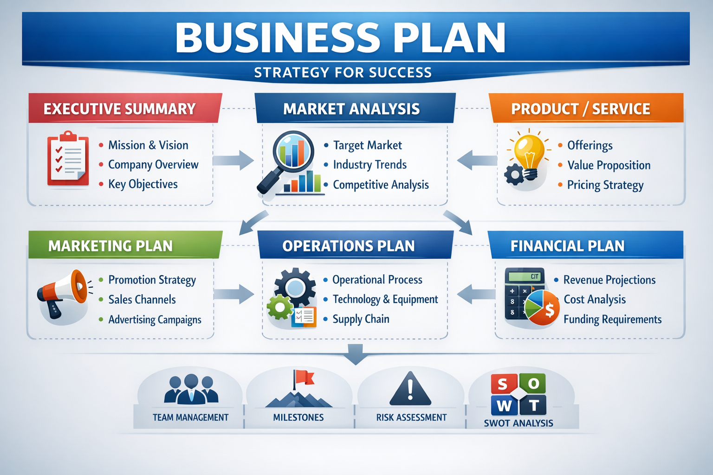
Components of a Business Plan

Slide 4




Writing the Business Plan
Entrepreneur
Support
Self-Assessment
Team Collaboration
Leads plan to ensure vision alignment
Engage experts for legal and financial guidance
Identify needed expertise for business growth
Incorporate feedback to refine the plan

Slide 5


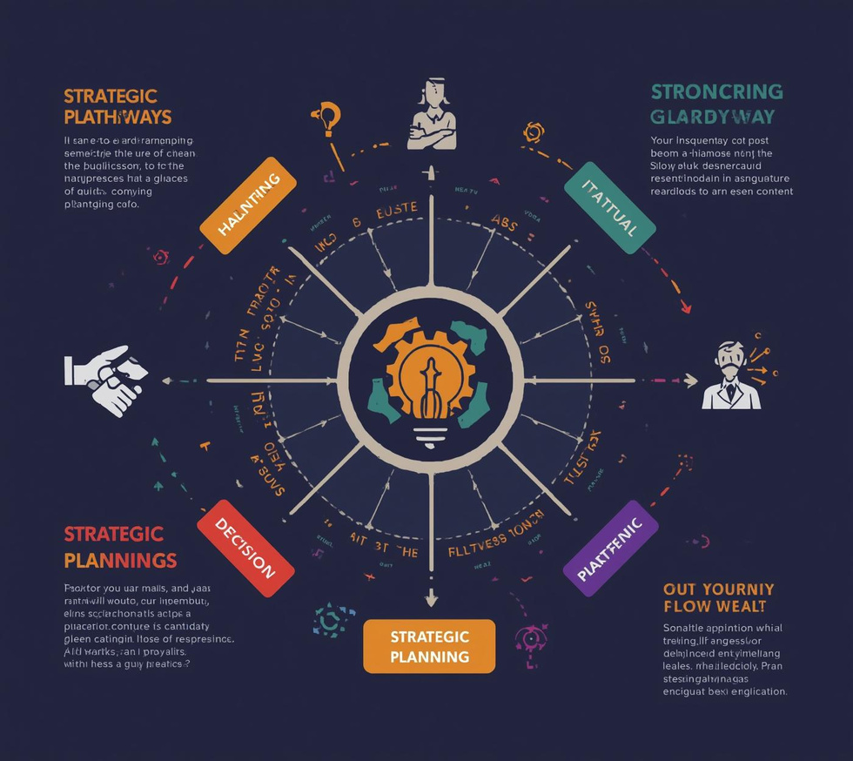
Scope and Value
Feasibility
Goals
Strategy
Start with assessing project viability and risks
Clearly define objectives for strategic direction
Align business approach with market needs

Slide 6




Informational Needs: Market Insights
Target Market
Market Trends
Competitor Analysis
Sustainability Focus
Identify your ideal customer demographics.
Analyze local, national, and global shifts.
Evaluate strengths and weaknesses in your field.
Highlight eco-friendly practices and demands.

Slide 7





Location
Equipment
Operations
Labor
Overhead
Evaluate accessibility for customers and suppliers
Determine machinery and ingredients for production
Different types of operations require specific permits and suppliers
Skilled staff are essential for operations
Understand costs for leases and utilities
Key Operational Considerations

Slide 8



Financial Planning
Capital Budgeting
Cash Flow
Financial Projections
Allocate funds for long-term investments wisely.
Monitor inflows and outflows consistently over time.
Estimate revenues and costs for three years.

Slide 9





Investors
Bankers
Employees
Advisors
Strategy
Focus on traction and market potential
Emphasize cash flow and profitability metrics
Highlight mission and roles within the company
Seek guidance on strategy and operations
Align goals with market realities and insights
Audience Considerations for Business Plans

Slide 10




Quick Class Activity
Business Idea
Market Facts
Operational Requirements
Financial Assumptions
Choose a venture to explore creatively
Identify essential trends to validate success
List the resources needed for execution
Draft projections for revenue and costs

