Slide 1

Chapter 8
The Marketing Plan Overview
Dr. Kheng
MGMT 420

Slide 2
Why Start with Industry Analysis
UNDERSTAND COMPETITION
Conducting an industry analysis allows businesses to grasp the competitive landscape. This understanding is critical before selecting effective marketing tactics to ensure a strategic approach.
IDENTIFY STRENGTHS
Analyzing competitors helps pinpoint their strengths and weaknesses. Recognizing what they excel at can reveal opportunities for differentiation and innovation in your own strategy.

Slide 3
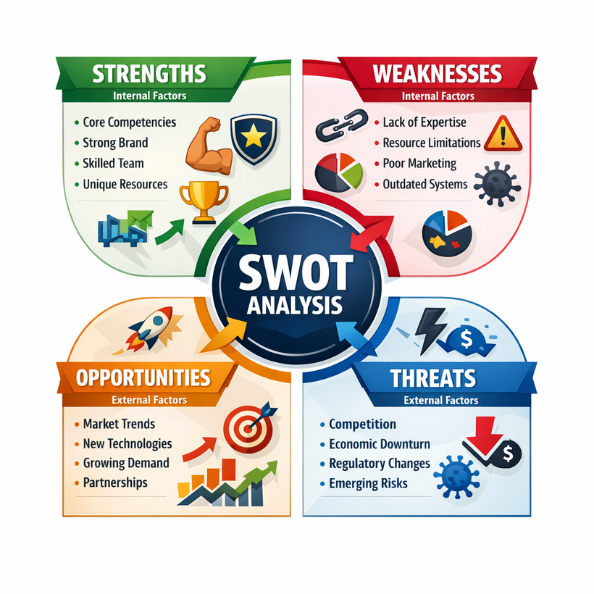
Tools for Analysis
SWOT OVERVIEW
The SWOT analysis identifies Strengths, Weaknesses, Opportunities, and Threats, helping businesses understand internal capabilities and external challenges, essential for strategic planning and decision-making.

Slide 4
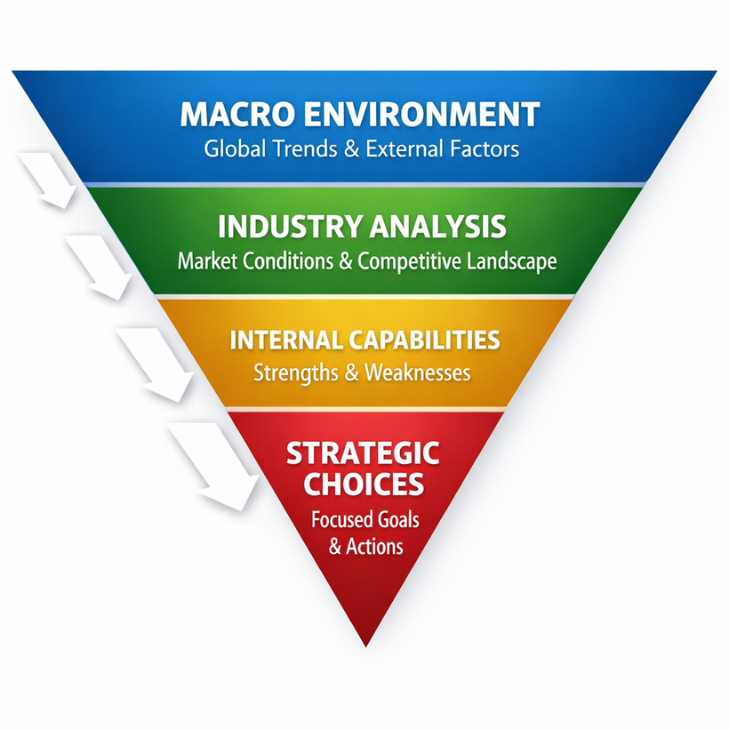
Tools for Analysis
THE PYRAMID TOOL
The upside-down pyramid organizes insights from broad environmental factors to narrow strategic choices, allowing businesses to focus on actionable items that align with market conditions and opportunities.

Slide 5
Competitor Analysis
WEBSITES & PRICING
Assessing competitor websites helps reveal their pricing strategies and promotional tactics. Analyze their offerings to identify strengths and weaknesses that inform your own venture's strategy.
REVIEWS & RATINGS
Customer reviews and ratings provide insights into what customers appreciate and what they find lacking. Identify patterns that highlight unmet needs or gaps in the market.
SOCIAL MEDIA INSIGHTS
Monitoring competitors' social media content reveals their engagement strategies and customer interactions. Analyze posts and comments to understand audience preferences and brand perceptions.

Slide 6
Understanding Your Market Landscape

Slide 7
Define Research Objectives
START WITH LEARNING
Clearly define what you need to learn to make informed decisions. This initial step ensures your research is focused and relevant to your venture's success.
TURN ASSUMPTIONS INTO QUESTIONS
Transform your assumptions into specific, testable questions. This approach helps clarify your research objectives and directs your data collection efforts effectively.

Slide 8
Secondary vs. Primary Data
SECONDARY DATA
Secondary data consists of free, existing sources that can quickly inform your market research, such as government reports, industry studies, and competitor websites.
PRIMARY DATA
Primary data involves gathering direct information through methods like surveys, interviews, and observations, providing tailored insights that are specific to your research objectives.

Slide 9
What a Marketing Plan Answers
WHERE HAVE WE BEEN?
Understanding our past performance helps identify patterns and trends, guiding future strategies. This insight is crucial for setting realistic goals based on historical data and market behavior.
WHERE DO WE WANT TO GO?
Establishing clear objectives allows us to define our desired outcomes and assess our progress. This forward-looking perspective aligns our marketing efforts with overall business goals and aspirations.

Slide 10
Characteristics of Effective Plans
STRATEGY-BASED
An effective marketing plan is strategy-based, aligning actions with overall business objectives, ensuring that every decision supports the venture's long-term vision and market positioning.
GROUNDED IN FACTS
Solid marketing plans are grounded in facts, relying on data-driven insights to validate decisions, facilitating adaptations based on real-world feedback, thus reducing risks associated with assumptions.

Slide 11
Segmenting the Market
DEMOGRAPHICS
PSYCHOGRAPHICS
Analyze age, gender, income, and education to understand your target audience.
Explore interests, lifestyles, and values to better connect with potential customers.
GEOGRAPHY
BUYING BEHAVIOR
Consider location-specific factors that influence buying habits and preferences.
Study purchasing patterns to tailor marketing strategies effectively for your audience.
EXAMPLE
A gym targets local professionals aged 25–35 seeking efficient HIIT workouts after work.

Slide 12
Set Goals & Objectives
SPECIFIC AND MEASURABLE
Goals should be specific and clearly defined to ensure everyone understands what needs to be achieved. Measurable objectives allow for tracking progress and evaluating success over time.
REALISTIC TARGETS
It's essential to set realistic targets that are achievable within the given resources and timeframe. Limiting to 6–8 goals helps maintain focus and ensures meaningful progress.

Slide 13
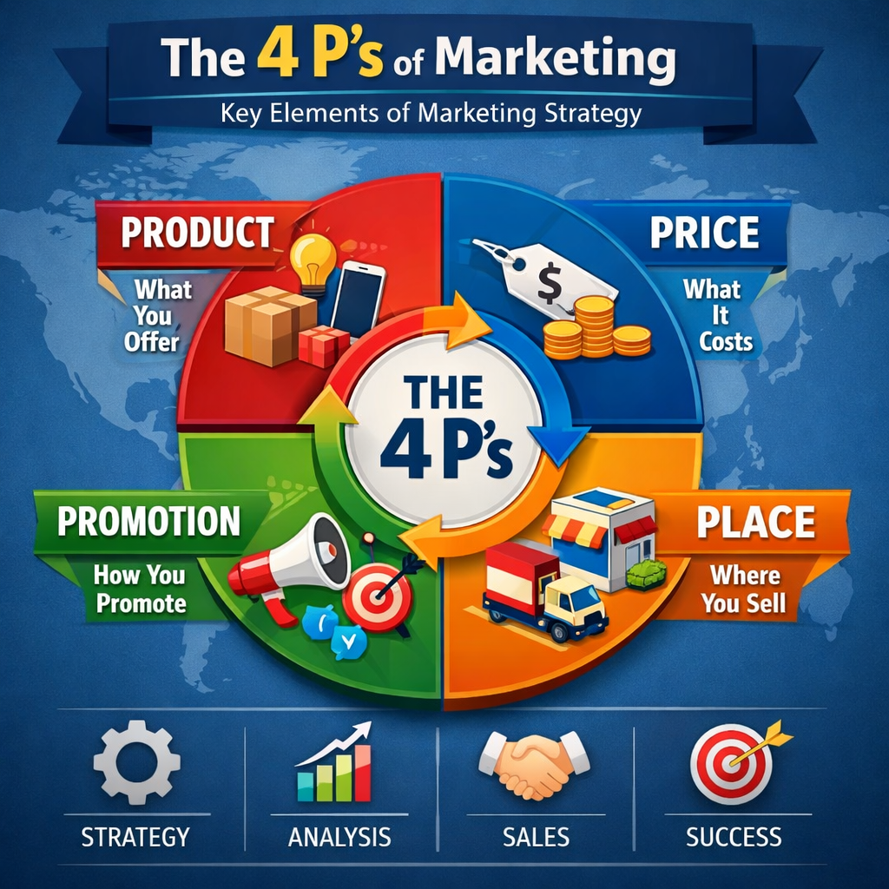
Marketing Strategy: The 4Ps
PRODUCT STRATEGY
The product strategy focuses on defining the offering.
PRICING STRATEGY
The pricing strategy involves determining the cost of the product.
PLACE STRATEGY
The place strategy focuses on where you will sell your product.
PROMOTION STRATEGY
The promotion strategy involves how you will advertise your product.

Slide 14
Budget Allocation
SALES PERCENTAGE
New ventures typically allocate 12–20% of projected sales for the marketing budget, ensuring sufficient resources are dedicated to effective promotion and brand visibility.
COST BREAKDOWN
It's essential to break down the budget into categories such as ads, events, email tools, and influencer partnerships, allowing for strategic allocation and financial tracking.

Slide 15
Implementation & Monitoring
ASSIGN TASKS
Clearly define roles for team members by assigning specific tasks. This accountability ensures everyone understands their responsibility in executing the marketing plan effectively and efficiently.
TRACK KPIS
Regularly monitor key performance indicators (KPIs) such as ROI, reach, and conversions. This data-driven approach enables timely adjustments to strategies, improving overall marketing effectiveness and adaptability.

Slide 16

Quick Recap
This recap highlights the key takeaways from our marketing plan discussion, ensuring you grasp the essential steps to craft effective strategies for your ventures.

