Slide 1



Course Introduction
Principles of
Marketing
Module 1
Orientation + What Marketing Is (and Isn't)
Instructor
Dr. Liz Kheng

Slide 2









Module 1
Module Overview:
A Customer-Focused System
"Marketing is not just ads. It’s a customer-focused system of decisions that creates, communicates, delivers, and exchanges value."
Goal
Focus
Outcome
Understand what matters to customers and design offerings around it. It starts with the customer, not the product.
Value creation. Balancing benefits against costs to create a proposition that earns loyalty over time.
Sustainable relationships and profitable exchanges. Marketing succeeds when both sides win.

Slide 3








Module 1
Learning Objectives
By the end of this module, you will be able to:
1
Define marketing beyond "advertising"
Explain marketing as a full decision system (research, strategy, product, price) rather than just promotion.
2
Explain Needs, Wants, and Demand
Distinguish between basic human requirements, cultural preferences, and buying power.
3
Identify Value Propositions
Spot and evaluate value propositions in real-world examples (benefits vs. reasons to believe).
4
Describe the Marketing Concept
Explain customer orientation: winning by understanding customers and delivering superior value.
5
Explain how exchange drives decisions
Connect marketing to the act of giving something up (money, time, data) in return for value.
Objectives

Slide 4







Core Concept
What Is
Marketing?
Official Definition
"The activity, set of institutions, and processes for creating, communicating, delivering, and exchanging offerings that have value for customers, partners, and society at large."
It's More Than Advertising
A common myth is that marketing is just "making people want stuff." In reality, marketing is the entire system of decisions (product, price, place) that happens long before an ad is ever seen.
Visual Context
Advertising is just the "megaphone."
While billboards like this are visible, marketing is the unseen system that designed the value being delivered.

Slide 5











Distinctions
Marketing vs. Advertising vs. Selling
Understanding the distinct roles within the value creation system.
Marketing
Advertising
Selling
The Plan
The Megaphone
The Close
Scope
Scope
Scope
Research, strategy, product design, pricing, distribution, communications, and relationship-building.
Paid media to inform or persuade at scale (TV, social ads, billboards).
Direct persuasion at the moment of decision, often one-to-one.
Purpose
Purpose
Purpose
Generate awareness, interest, and preference.
Convert interest into a transaction (purchase).
Create and sustain value; build long-term loyalty.
Limitation
Tools
Timeline
Can't fix a bad product or weak value proposition.
Demos, promotions, negotiations, personal interaction.
Happens before, during, and after the sale.
Focus: Long-term Value
Focus: Visibility
Focus: Transaction

Slide 6














Decision Framework
Marketing as a System of Decisions
Integrated Approach
How is it delivered?
Who is it for?
Distribution channels, access, & convenience.
Target segments & positioning strategies.
How is it communicated?
What is offered?
Product features, design, quality, & service.
Marketing
System
Messaging, media mix, & promotion timing.
Value Creation
How is it priced?
How are relationships built?
Price levels, payment terms, & perceived value.
Customer experience, support, & loyalty programs.
These six decision areas must work together to create a consistent value proposition.

Slide 7






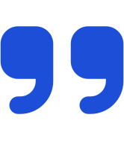



Philosophy
The Marketing
Concept
Key Implications
Customer Orientation
Start with Insights
Don't start with the product. Start by deeply understanding the customer's problem. Design the solution backwards from their needs.
Official Definition
Make Strategic Trade-offs
"Achieving organizational goals depends on knowing the needs and wants of target markets and delivering the desired satisfactions better than competitors do."
You cannot satisfy everyone. Customer orientation means choosing which customers to serve and prioritizing what matters most to them.
Align the Organization
Marketing isn't just a department. The entire organization (R&D, finance, operations) must be aligned to deliver the promised value.
Shift from "Make & Sell" to "Sense & Respond"

Slide 8












Core Concepts
Needs, Wants, and Demand
The fundamental progression that drives marketing.
1. Needs
2. Wants
3. Demand
Basic Requirement
Specific Preference
Buying Power
States of felt deprivation. Physical (food, clothing, warmth, safety), social (belonging), and individual (knowledge, self-expression).
The form human needs take as they are shaped by culture and individual personality. Marketing influences wants, but does not create needs.
Human wants that are backed by buying power.
People demand products with benefits that add up to the most value and satisfaction for their money.
Example
Example
"I want a LaCroix Sparkling Water."
Example
"I am thirsty."
"I have $2 and I am buying it."
A physiological state.
Shaped by culture/taste.
Willingness + Ability to pay.
Marketing cannot create needs, but it shapes wants and influences demand.

Slide 9

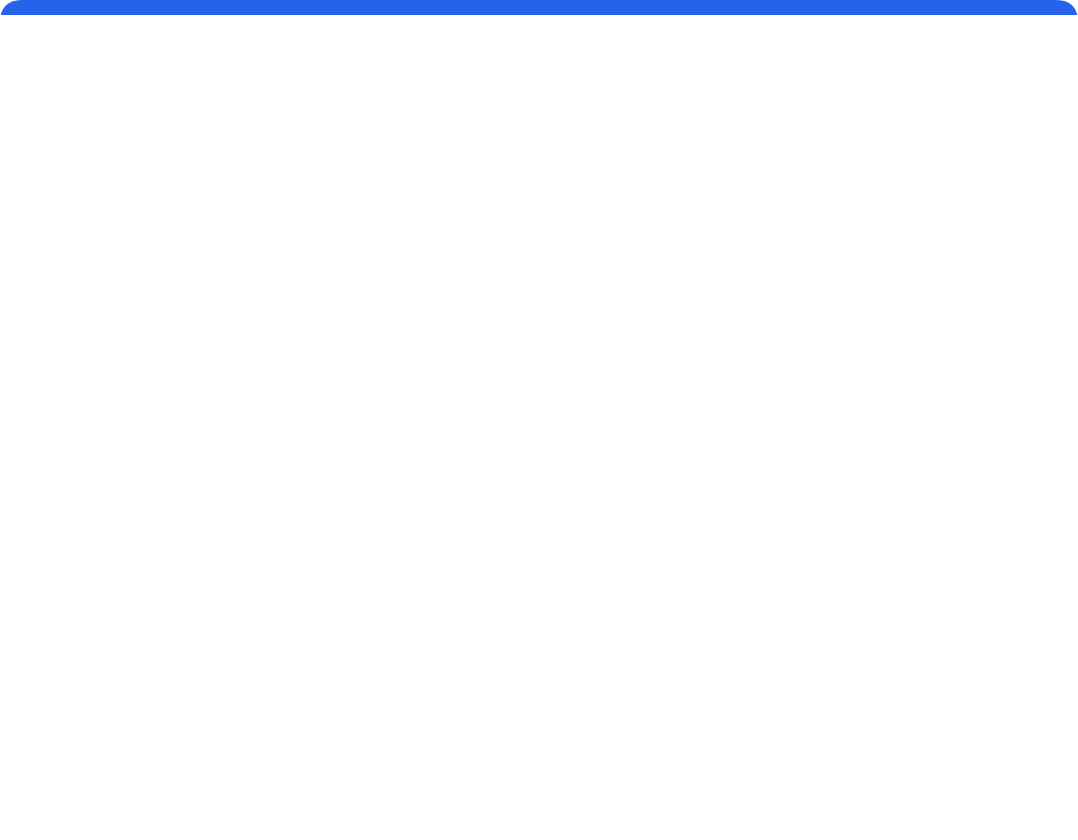











Core Framework
The Value Equation
"Value is subjective."
VALUE
=
Benefits
−
Costs
Perceived Worth
What you get
What you give
Marketing Goal: Increase perceived benefits or decrease perceived costs to maximize value.
Total Benefits
Total Costs
The "Get" Side
The "Give" Side
Functional Benefits
Monetary Costs
Product performance & features
Purchase price
Quality and durability
Taxes, shipping, maintenance fees
Emotional Benefits
Time & Energy
Feeling smart, safe, or proud
Search time & waiting time
Status and social recognition
Physical effort & learning curve
Experiential Benefits
Psychological / Risk
Sensory enjoyment (taste, design)
Stress or frustration
Convenience and ease of use
Risk of poor performance

Slide 10














Strategic Tool
Value Proposition
"Why should I buy from you?"
Definition
The Framework
Template
The full mix of benefits on which a brand is positioned. It is a clear statement that explains how your product solves customers' problems or improves their situation, delivers specific benefits, and tells the ideal customer why they should buy from you and not from the competition.
For , our provides because .
[Target Customer]
[Product/Service]
[Reason to Believe]
[Key Benefit]
Criteria for Success
Fill in the blanks
Connects needs to solutions
Clear: Easy to understand instantly.
Relevant: Explains how it solves a problem.
Differentiated: Explains why it's better.
Applied Example
Credible: Provides a reason to believe.
Scenario: Campus Navigation App
"For commuter students, our app provides faster campus navigation because it uses real-time building and route data."
Benefit
Proof
Save Time (Faster)
Real-time Data

Slide 11



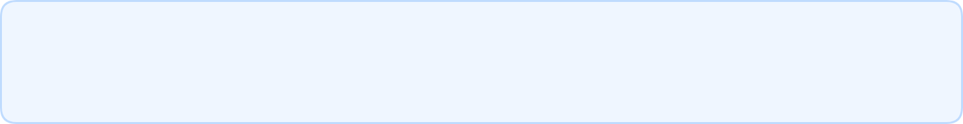
















Core Mechanism
Exchange: The Core of Marketing
"Value for Value"
Customer Receives
Solutions
Experiences
Outcomes
Marketer
TRANSACTION
Customer
Creates & Delivers
Customer Gives
Seeks Solutions
Money
Time
Data
Provides Value
Pays Costs
The Golden Rule of Exchange
Exchange only happens when Perceived Value ≥ Total Cost.

Slide 12

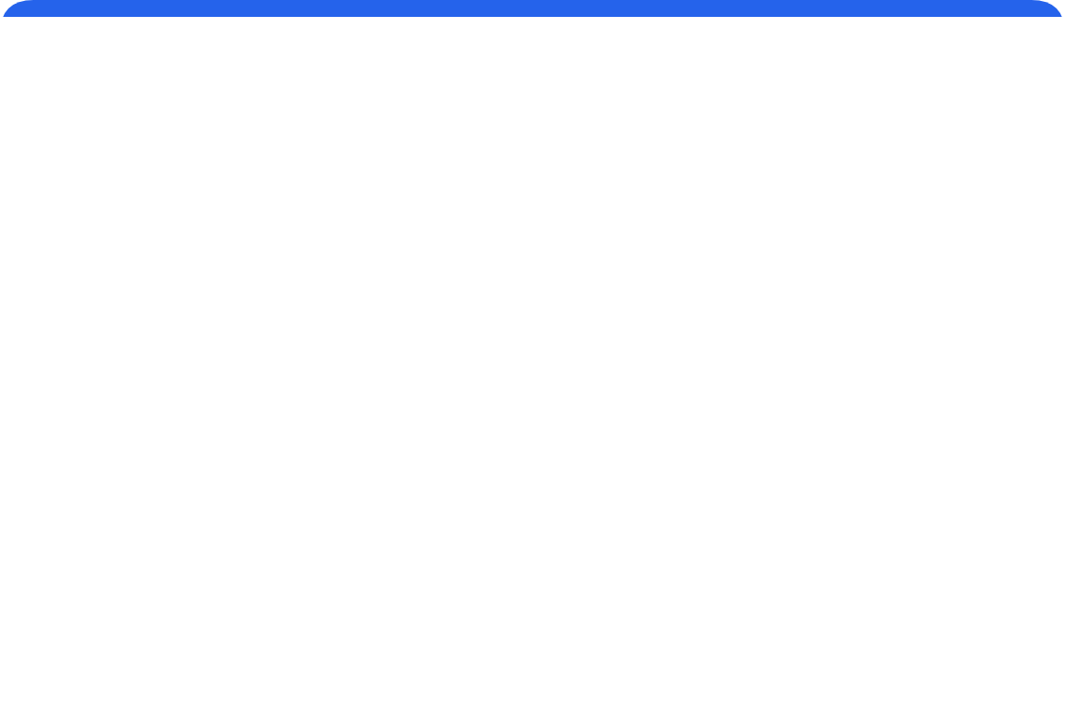





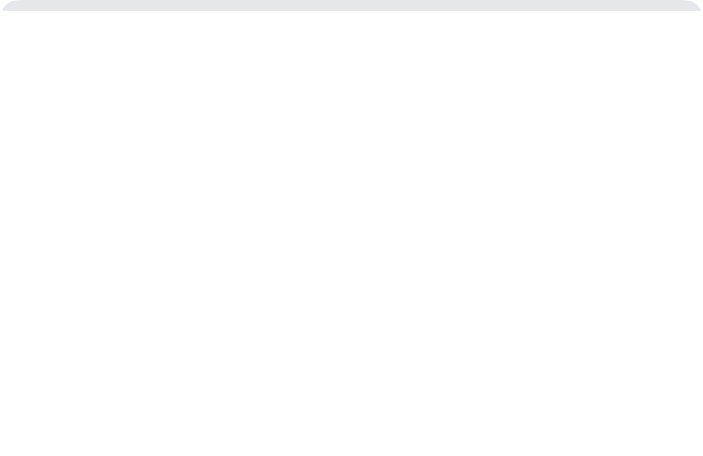


Module Summary
Key Takeaways
"Five things to remember"
Marketing is a System
Customer Orientation
Needs, Wants, Demand
It is not just "ads." It is a coordinated set of decisions (product, price, place, promotion) designed to create value.
Success depends on deeply understanding target customers and delivering superior value better than competitors do.
Needs are basic requirements; Wants are learned preferences; Demand is a want backed by the ability to pay.
Value Equation
The Exchange Rule
Value = Benefits − Costs.
Customers weigh functional and emotional benefits against money, time, and effort costs.
Exchange is the core mechanism of marketing. It only happens when the customer believes the trade-off is worth it.
Principles of Marketing

Slide 13





Competency Check
Quiz Preparation
"You should be able to..."
Define Marketing
Explain the Value Equation
Define marketing beyond "advertising" as a full system of decisions (product, price, place, promotion) that creates value.
Describe Value = Benefits − Costs using examples of functional/emotional benefits and non-monetary costs (time, effort).
Distinguish Key Concepts
Write a Value Proposition
Explain the difference between Marketing (the plan), Advertising (the communication), and Selling (the close).
Draft a statement using the framework: "For [target], [product] provides [benefit] because [reason to believe]."
Need → Want → Demand
Provide an original example tracing a basic Need, how it becomes a specific Want, and when it becomes Demand (backed by buying power).
Study Tip
Focus on the "why." Why does a customer choose Product A over Product B? It's always about the Value Equation.
Module 1 Complete

