Slide 1



Principles of Marketing
Module 2
Funding My Startup
Strategy, Environment, and SWOT for Smart Decisions
Instructor
Dr. Liz Kheng

Slide 2

Module 2: Funding My Startup
Overview
"Great products can still struggle. Marketing success requires clear strategy and awareness of the environment."
Welcome
What we'll cover:
In this module, you’ll learn how marketers see the situation clearly and make strategic decisions that fit reality.
Responding to student schedules & budgets
Analyzing trends & competitors
Adapting to technology & expectations
Principles of Marketing
|
02

Slide 3
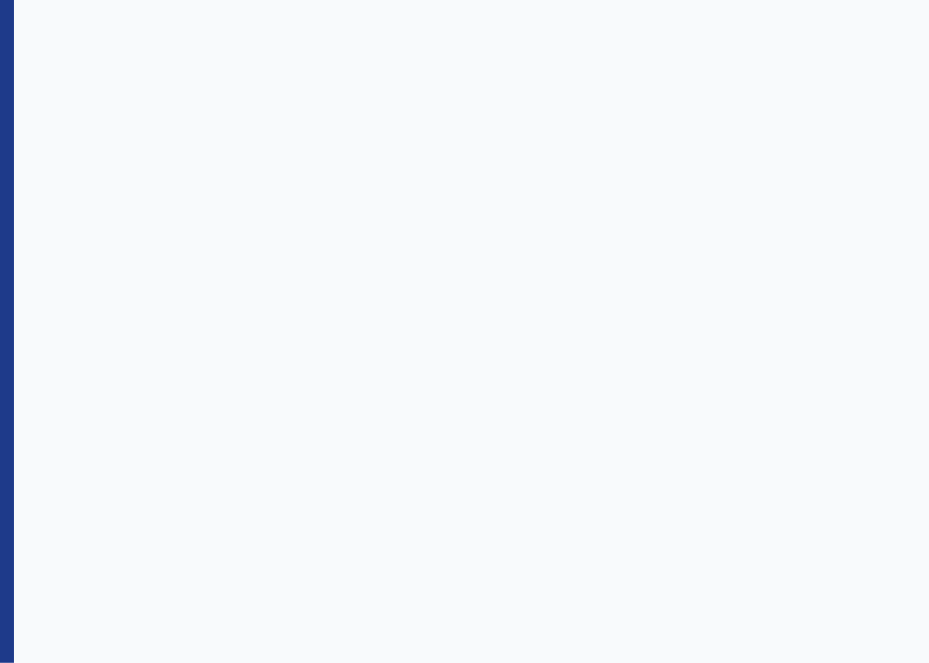
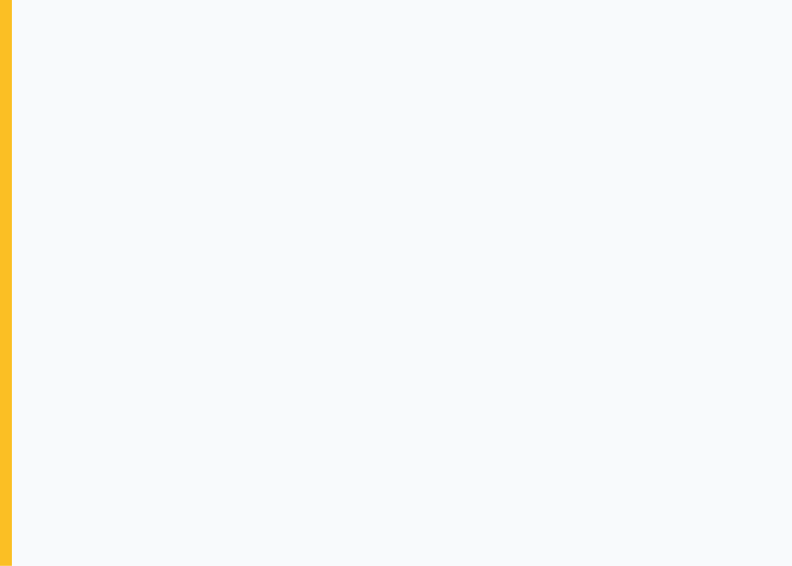


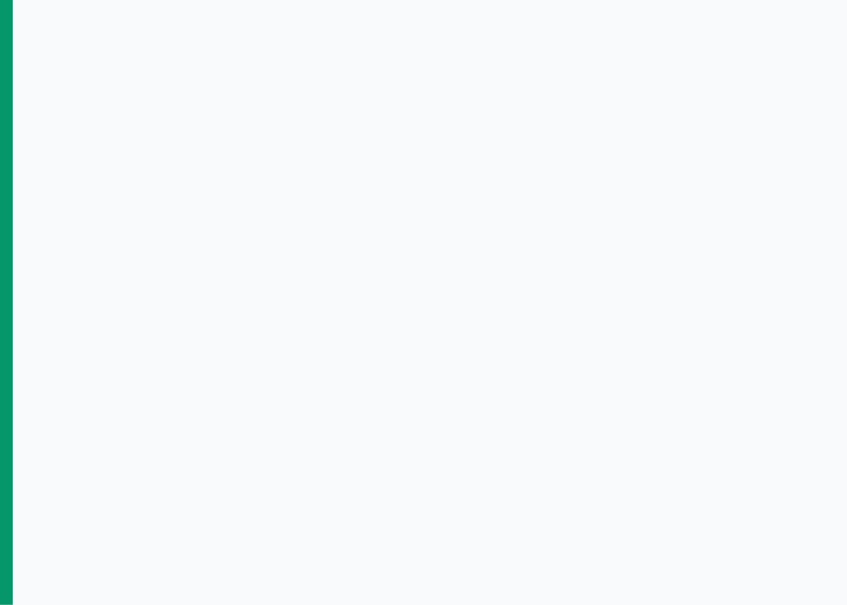
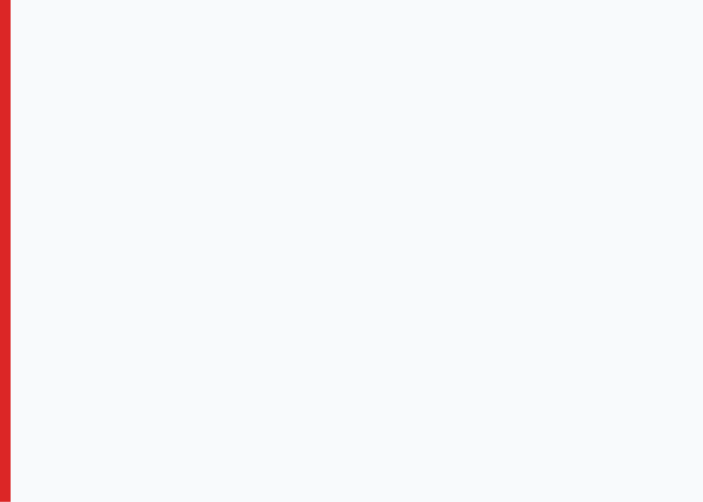


Module 2
Strategy vs. Tactics
Marketing Environment
Explain the fundamental difference between strategic direction and tactical execution.
Identify key forces: social, technology, economic, legal, and competitive.
Outcomes
Learning Objectives
SWOT Analysis
Strategic Recommendation
Complete a basic SWOT analysis distinguishing internal and external factors.
By the end of this module, you will be able to master these four core competencies.
Use SWOT findings to formulate realistic, actionable strategy recommendations.
Funding My Startup
Principles of Marketing
|
03

Slide 4









Core Concept
Module 2
Strategy vs. Tactics
"Strategy improves value; tactics communicate it."
Strategy
Tactics
The "How We Win" Choice
The Specific Actions
The Big Decision: Defines who you serve, what value you deliver, and how you differ.
The Execution: Specific things you do to support the plan (posts, coupons, events).
Timeframe: Long-term. Guides decisions for months or years.
Timeframe: Short-term. Can change weekly or daily.
Key Question: "If we can’t be everything to everyone, who are we best for—and why?"
Key Question: "What are we doing this week to support the strategy?"
Principles of Marketing
|
04
The Quick Test
If it changes weekly
If it guides for months
How to tell them apart instantly
Likely a Tactic
Likely a Strategy

Slide 5









Case Story
Module 2
The Late-Night Dining Problem
"Why marketing fails when you skip strategy."
1
2
3
The Observation
The Mistake
The Strategic Approach
A campus dining location notices a troubling pattern:
The manager jumps straight to tactics:
Instead of noise, ask strategic questions to improve value:
"We need marketing—let’s post more on social media."
"There's nowhere good to eat after 8 PM."
Choose a Target
Late-study students? Athletes? Commuters?
Define Value
Foot traffic drops sharply after dinner hours.
Actions Taken:
What do they need? (Speed, warmth, predictability)
Increased posting
Design the Offer
Staff is idle while students go elsewhere.
Printed flyers
Create something better than alternatives (vending, leftovers).
Ran a giveaway
Result: Almost no change.
Principles of Marketing
|
05

Slide 6







Strategic Application
Module 2
Strategy Statement Example
The Strategy
"Target students studying late and position our location as the fast, warm, affordable late-night option with a predictable menu and a 5-minute pickup experience."
Directs
Aligned Tactics
Now the actions make sense because they serve the goal:
Timing
Product
Promotion
Place
Extend hours only on high-demand nights
Create "Late Night Combo" under fixed price
Post menus during peak study times
Simple signage near study spaces
Principles of Marketing
|
06
Key Insight
Strategy improves value; tactics communicate it.

Slide 7







Core Concept
Module 2
Competitive Advantage
"Why customers pick you over alternatives."
Convenience
Price / Value
Quality
Being the fastest, easiest, closest, or simplest option.
Offering the best deal, bundles, or loyalty rewards.
Works better, tastes better, lasts longer, or has superior features.
e.g., Drive-thru, One-click buy
e.g., Student discount, BOGO
e.g., Hand-crafted, Durable
Real Life Example
Identity
Experience
The Coffee Shop Strategy
Fits the customer's lifestyle, values, or community belonging.
Friendly service, smooth process, predictable atmosphere.
Coffee is a commodity. Customers return because of specific advantages:
Principles of Marketing
|
07
Predictable quality
Speed of service
e.g., Sustainable, Luxury
e.g., "Welcome back!", Ambiance
Rewards/Loyalty

Slide 8

Module 2: Funding My Startup
Core Concept
"Marketing decisions are shaped by uncontrollable forces that dictate the reality of the marketplace."
The Marketing Environment
Environmental Forces Shape:
Customer Desires: Trends define what is popular or expected.
Think of the environment as the "weather" around your business. You cannot control it, but you must plan for it. It fundamentally shapes what customers want, what they can afford, and what feels "normal."
Buying Power: Economic shifts change what people can afford.
Trust & Ethics: Legal and social norms set the rules of the game.
Competition: Technology introduces new rivals and solutions.
Principles of Marketing
|
02

Slide 9






Environmental Analysis
Module 2
Five Environmental Forces
"The weather around your business—uncontrollable but essential to plan for."
Social & Cultural
Technology
Economic
Shifts in demographics, lifestyles (wellness), values, and changing expectations (inclusion, transparency).
Changes how people discover products, how they buy, and the speed/convenience they expect.
Conditions influencing buying power and spending patterns. Tight budgets make customers price-sensitive.
Mini-Case: The Protein Trend
Mini-Case: Mobile Ordering
Mini-Case: Tight Budgets
Students ask for "high-protein" options. Marketing response: clearer labeling & new routine bundles.
Ordering ahead becomes "normal." Waiting in line is now a "cost." Speed is a requirement.
Students buy fewer add-ons. Marketing response: "Best Value" bundles and smaller sizes.
Legal & Ethical
Competitive
Laws protecting competition and consumers (privacy, truth-in-advertising, accessibility).
Direct: Same category (Coffee vs. Coffee).
Indirect: Different solution (Coffee vs. Energy Drink).
Mini-Case: The Risky Claim
Mini-Case: The Indirect Surprise
"Guaranteed results in 24 hours." Untrue claims lead to refunds, legal risks, and lost trust.
Sales drop not because of a new café, but because a store discounted energy drinks.
Principles of Marketing
|
09

Slide 10
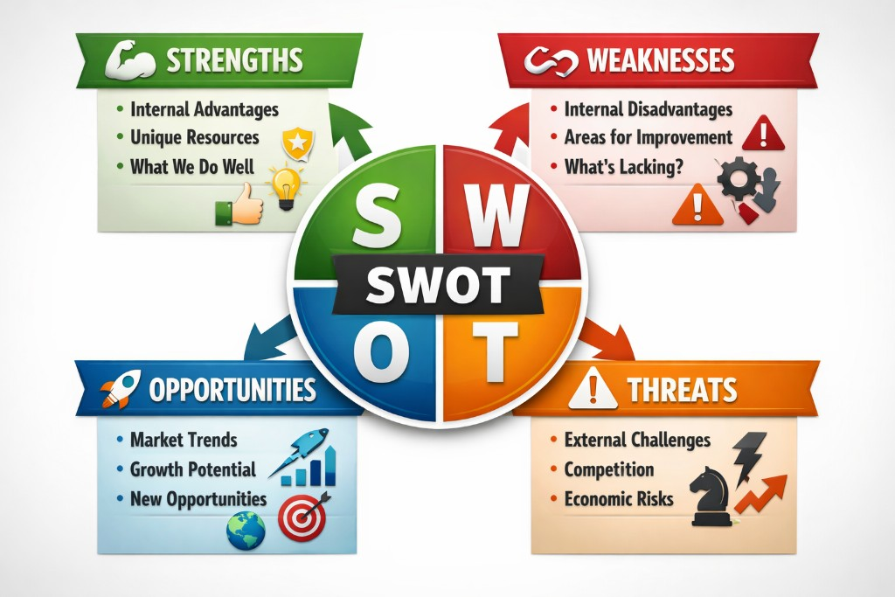

Core Tool
Module 2
SWOT Analysis: The Framework
The #1 Mistake
Mixing internal and external factors. Keep them separate to make clear decisions.
"Use SWOT to organize reality into a decision: Match your internal strengths with external opportunities."
Principles of Marketing
|
10

Slide 11









Framework Breakdown
Module 2
SWOT Components
"Defining the four dimensions of strategic analysis."
Helpful (to achieving goal)
Harmful (to achieving goal)
Strengths
Weaknesses
The Quick Rule
Internal Advantages
Internal Limits
Capabilities, resources, and positive attributes you control.
Gaps, limitations, or negative factors you control but need to fix.
"How do I know if it's Internal or External?"
Internal
Internal (S/W)
Strong brand reputation
Slow delivery time
If your organization could or has direct control over it.
Unique technology
Limited budget
change it quickly
External (O/T)
Opportunities
Threats
If it happens "out there" regardless of what you do (trends, economy).
External Trends
External Risks
External
Trends, shifts, or situations in the environment you can benefit from.
Forces in the environment that could hurt your performance.
Avoid the #1 Mistake
Principles of Marketing
|
11
Competitor leaves market
Economic downturn
Don't list "Market is growing" as a Strength. That's an Opportunity.
New technology usage
Changing regulations

Slide 12








Case Study
Module 2
Marco's Pizza Shop
"The product is strong, but the customer's choice is changing."
1
2
3
The Context
The Shift
The Key Insight
Marco's is a beloved, family-owned shop known for high quality.
Delivery orders are slipping. Students are choosing SliceDash instead.
The problem isn't the pizza. The definition of value has changed.
"Best pizza near campus... fresh every time."
"Marco's is the best... but it takes forever when you're hungry."
Students are valuing:
Speed
Ease
Certainty
Dough made in-house daily.
Competitor Advantage:
"Marco's wins on quality, but SliceDash is winning on friction reduction."
Loyal in-store regulars.
"Delivered in 25 mins"
Live tracking
Marketing must respond to value, not just visibility.
No phone calls needed
Principles of Marketing
|
12

Slide 13









Case Study Application
Module 2
Marco's Pizza — SWOT
"Applying the framework to understand the strategic situation."
Helpful
Harmful
Key Insights
Strengths
Weaknesses
Marco's has a superior product (Strength) but is losing because the environment has shifted to value convenience and speed (Threat/Opportunity gap).
Strong reviews & reputation
Slow delivery times
Internal
High product quality (better taste)
Outdated ordering process (phone)
Loyal repeat customers
Inconsistent peak-hour staffing
The Core Problem
Students are trading off quality for certainty. Marco's "friction" (phone calls, waiting) is now a major cost.
Opportunities
Threats
Strategic Clue
"The reviews are still strong, but delivery orders are slipping."
Increased late-night food demand
Competitor discounts & speed (SliceDash)
Marketing doesn't need to fix the pizza; it needs to fix the access.
External
Students prefer mobile ordering
Delivery apps raising expectations
Partnerships with student orgs
Shift to "good enough + fast"
Principles of Marketing
|
13
NEXT STEP:
Turn this into a Strategy Recommendation

Slide 14






Strategic Process
Module 2
Turning SWOT into Strategy
Use a Strength
Capture Opportunity
Fix Weakness
Model Recommendation (Marco's Pizza)
“
The 5-Step Formula
Target and position the shop as the late-night pizza by adding a , creating a limited menu for speed, and bundling group deals to compete with discount-driven rivals.
1
Lead with value
late-night student groups
best-tasting, most reliable
2
Choose a target
simplified online ordering option
3
Use your strength
Target
Value/Strength
The Fix (Weakness)
4
Fix the barrier
5
Make one clear move
Notice: It doesn't just say "do marketing." It identifies WHO, WHY, and specifically HOW to overcome the friction.
Principles of Marketing
|
14

Slide 15











Practice Case
Module 2
The Tutoring Center Students Can't Find
"Good product, high friction, hidden competitors."
1
2
3
The Reality
The Friction
The Real Competitors
The service works well, but it's invisible to those who need it most.
The process creates barriers when students are already stressed.
You aren't just competing with other tutors. You compete with behaviors.
"We have tutoring? I think it's somewhere in the student center..."
Pain Points:
YouTube / AI Tools
Confusing, outdated website
Instant, free, low-effort help.
Login hurdles & password resets
Group Chats
Low awareness until students are already failing.
"Someone just send the answer."
Wait times of 4+ days
Inaction
High quality product (grades improve), but low usage.
Skipping the assignment entirely.
"This is too much. I'll just figure it out later."
Principles of Marketing
|
15

Slide 16








Student Exercise
Module 2
Apply SWOT → Strategy
"Using the Tutoring Center case, draft the following components."
Strength (Internal)
What does the center do well that creates real value now?
?
The Recommendation
Weakness (Internal)
Write a 4–6 sentence strategy that:
What internal barrier is preventing students from using the service?
Identifies a specific target student group
Opportunity (External)
Increases perceived value & reduces friction
What external trend or situation could the center leverage?
Uses at least one Strength + Opportunity
Addresses at least one Weakness or Threat
Threat (External)
Which alternative behavior pulls students away?
Tip: Focus less on "promoting harder" and more on making tutoring feel easy, fast, and low-stress.
Principles of Marketing
|
16

Slide 17
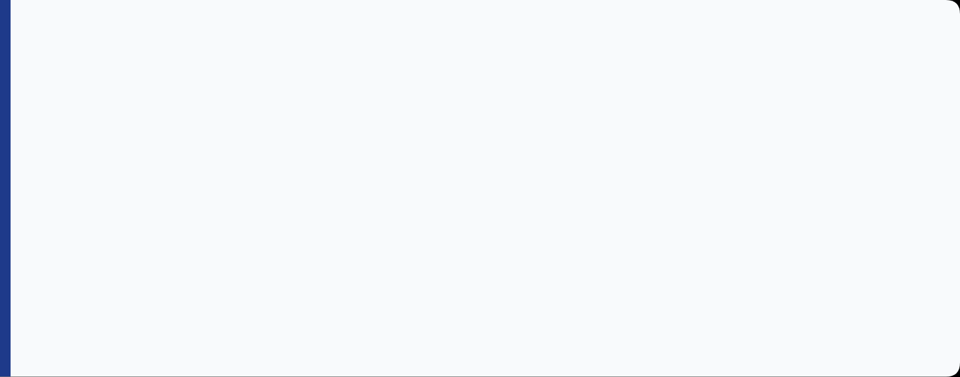



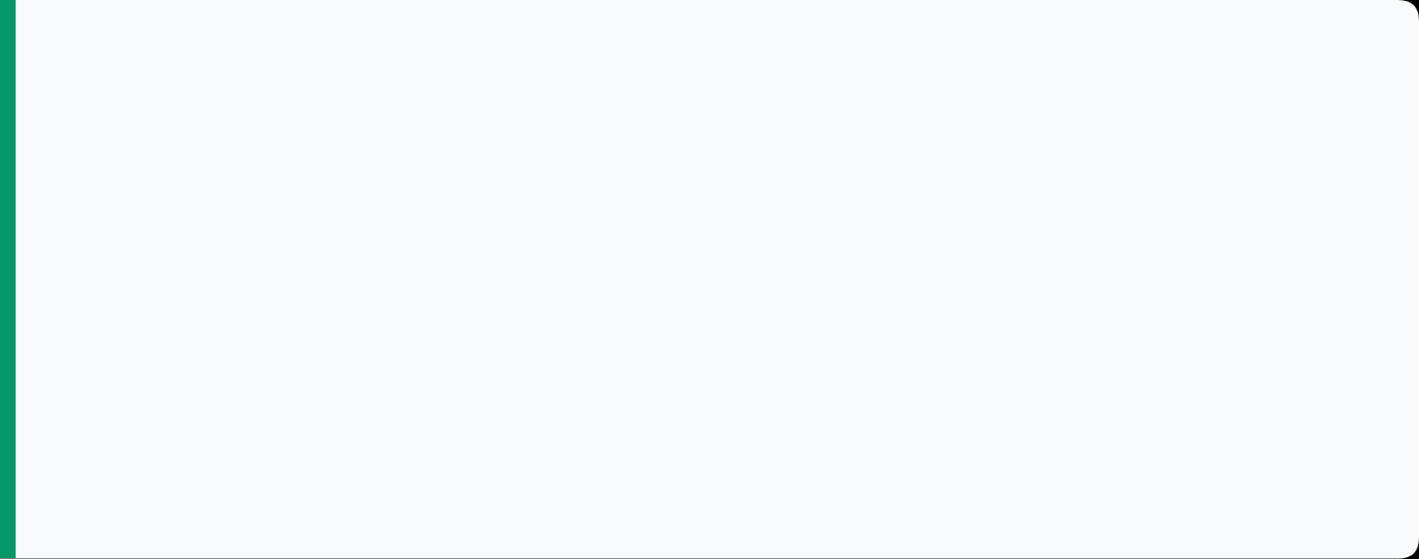
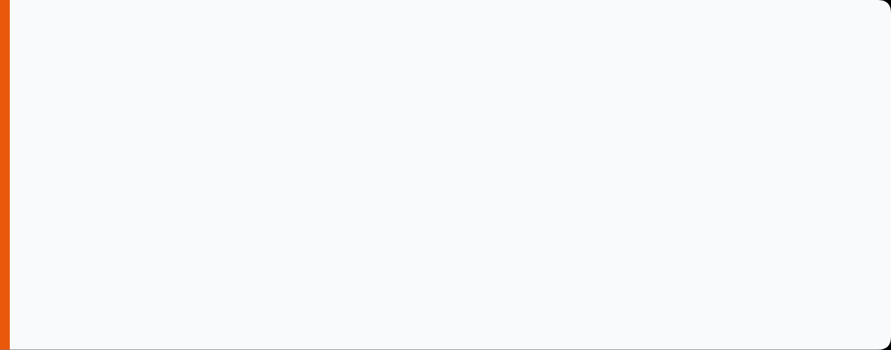


Module Wrap-Up
Module 2
Key Takeaways
Environment Shapes Value
Strategy is a Choice
External forces (social, tech, economic) change what customers value. You can't control the "weather," but you must plan for it.
Strategy defines how you will win and who you are best for. Tactics are just the actions that support it.
SWOT Organizes Reality
The Goal is Action
Separate Internal (Strengths/Weaknesses) from External (Opportunities/Threats) to make smart decisions.
Don't just list bullets. The goal of analysis is a clear strategy recommendation that fixes a problem or captures an opportunity.
Principles of Marketing
|
17

