Slide 1




Principles of Marketing
Module 4: Funding My Startup
Positioning, Differentiation
& Value Propositions
Instructor
Dr. Liz Kheng
University Marketing Dept.

Slide 2


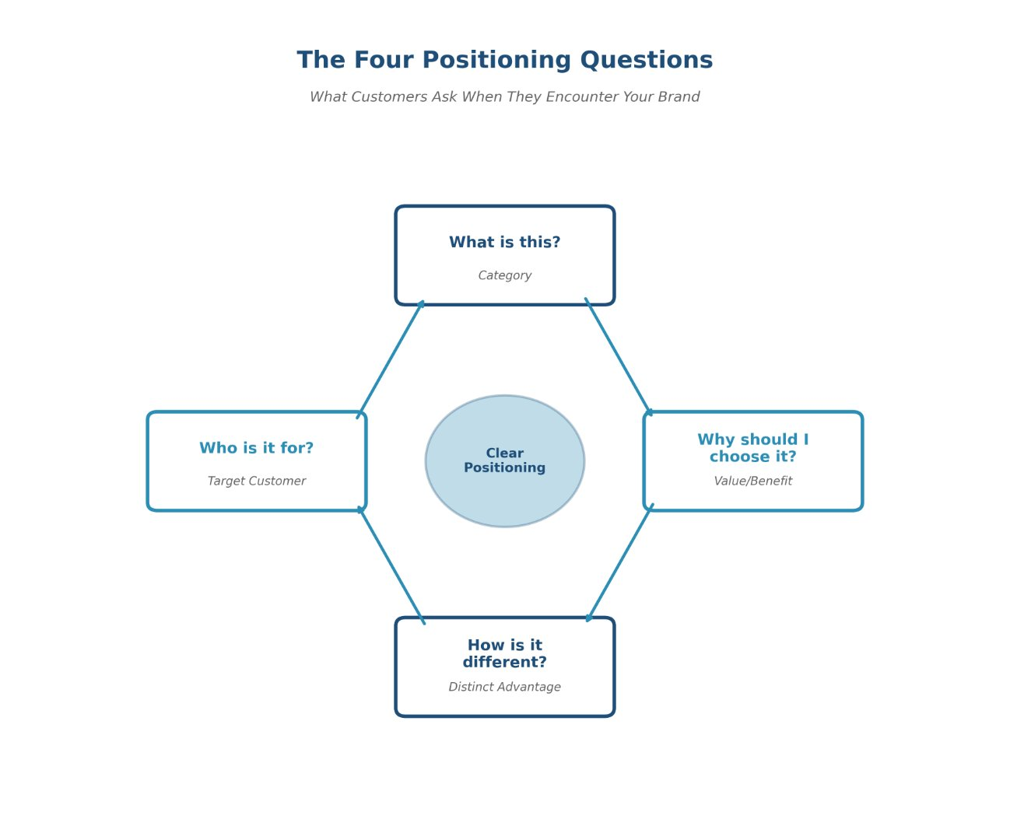




What is Positioning?
Core Concept
The "mental shortcut" customers use to understand your brand instantly.
Four key questions customers ask:
What is this?(Category)
Who is it for?(Target Customer)
Why should I choose it?(Value/Benefit)
How is it different?(Distinct Advantage)
Principles of Marketing • Module 4
2

Slide 3











The Cost of Confusion
When positioning isn't clear, customers make assumptions:
Case Study: Fusion Fest
Real World Example
"Probably too expensive"
Vague Messaging
"Not for someone like me"
"A celebration of everything for everyone."
"Just like all the others"
Clear Positioning
"One-night cultural mashup for first-years: food, music, and clubs—5–9pm at Union Lawn."
Confusion costs you attention, clicks, and customers.
Principles of Marketing • Module 4
3

Slide 4


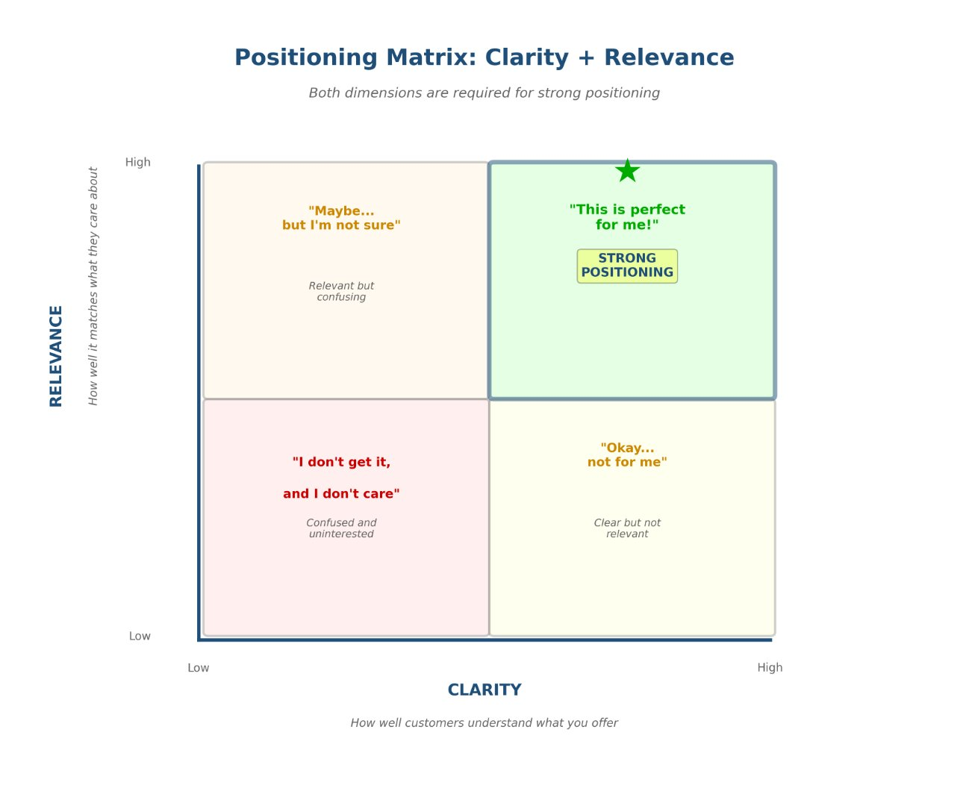


Positioning = Clarity + Relevance
Successful positioning requires balancing two critical dimensions simultaneously:
Clarity
People understand instantly what you offer.
Relevance
Matches exactly what they care about right now.
The Goal: Be both Obvious + Meaningful
Principles of Marketing • Module 4
4

Slide 5









Real-World Examples
Positioning turns generic services into specific solutions:
Why It Works
Strategy
Campus Gym
Specific Audience
"Beginner-friendly workouts for students who feel intimidated."
Not just "students," but students who are busy, intimidated, or struggling.
Clear Context
Addresses the exact moment of need: "between classes" or "gateway courses."
Meal Plan
"Fast grab-and-go meals between classes."
Emotional Relevance
Removes friction like "judgment" or "intimidation" to lower barriers.
Tutoring
"Quick help for gateway courses—no judgment, easy booking."
Notice how each example names a specific audience and a specific benefit.
Principles of Marketing • Module 4
5

Slide 6



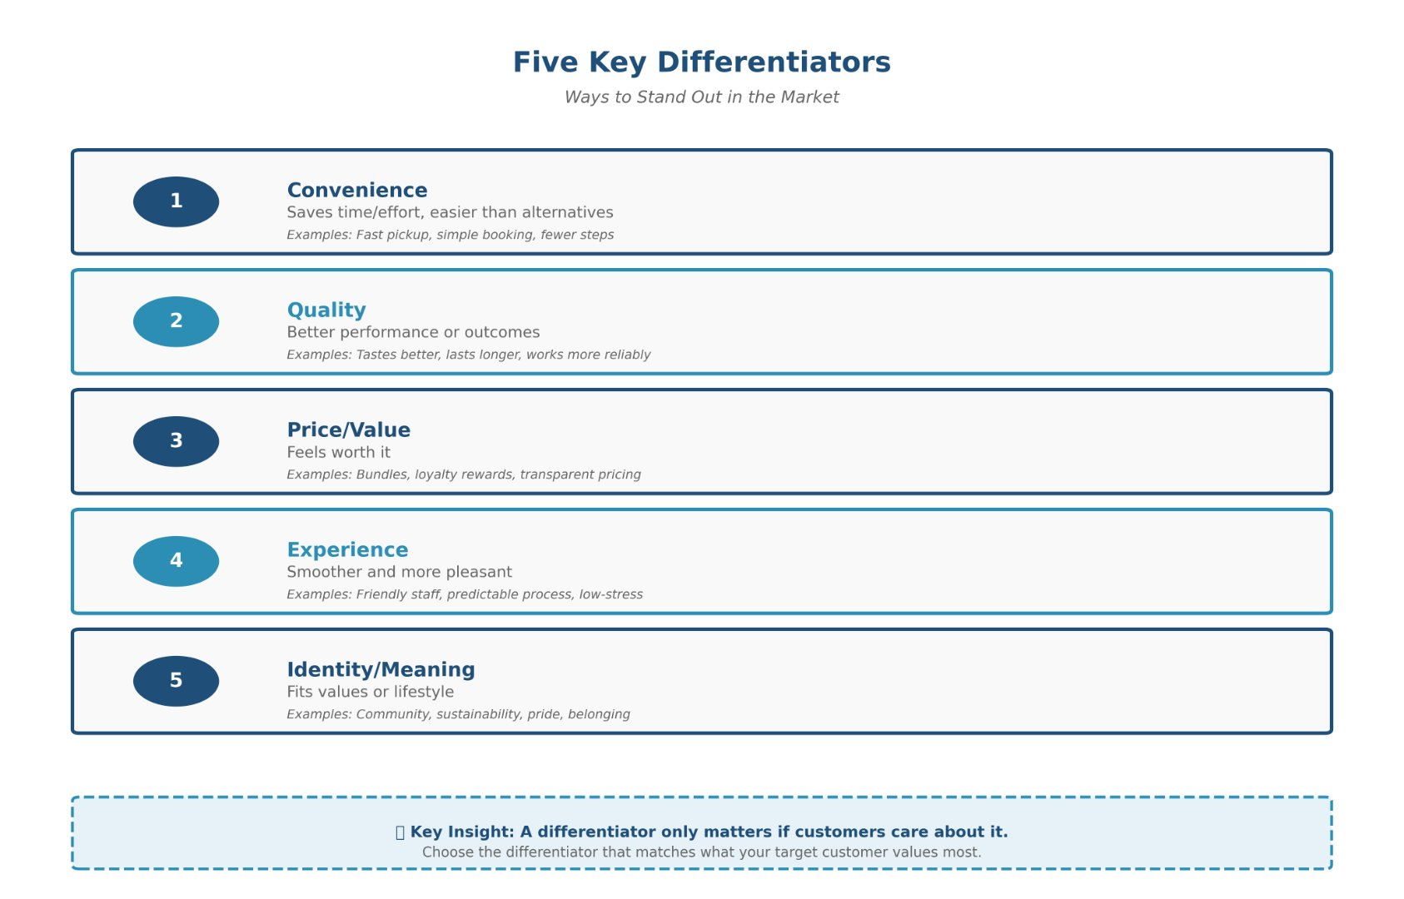




The Five Types of Differentiation
Convenience
Saves time or reduces effort
Quality
Better performance or durability
Price / Value
Feels worth the cost
Experience
Smoother and more pleasant interactions
Identity / Meaning
Fits personal values or lifestyle
Principles of Marketing • Module 4
6

Slide 7


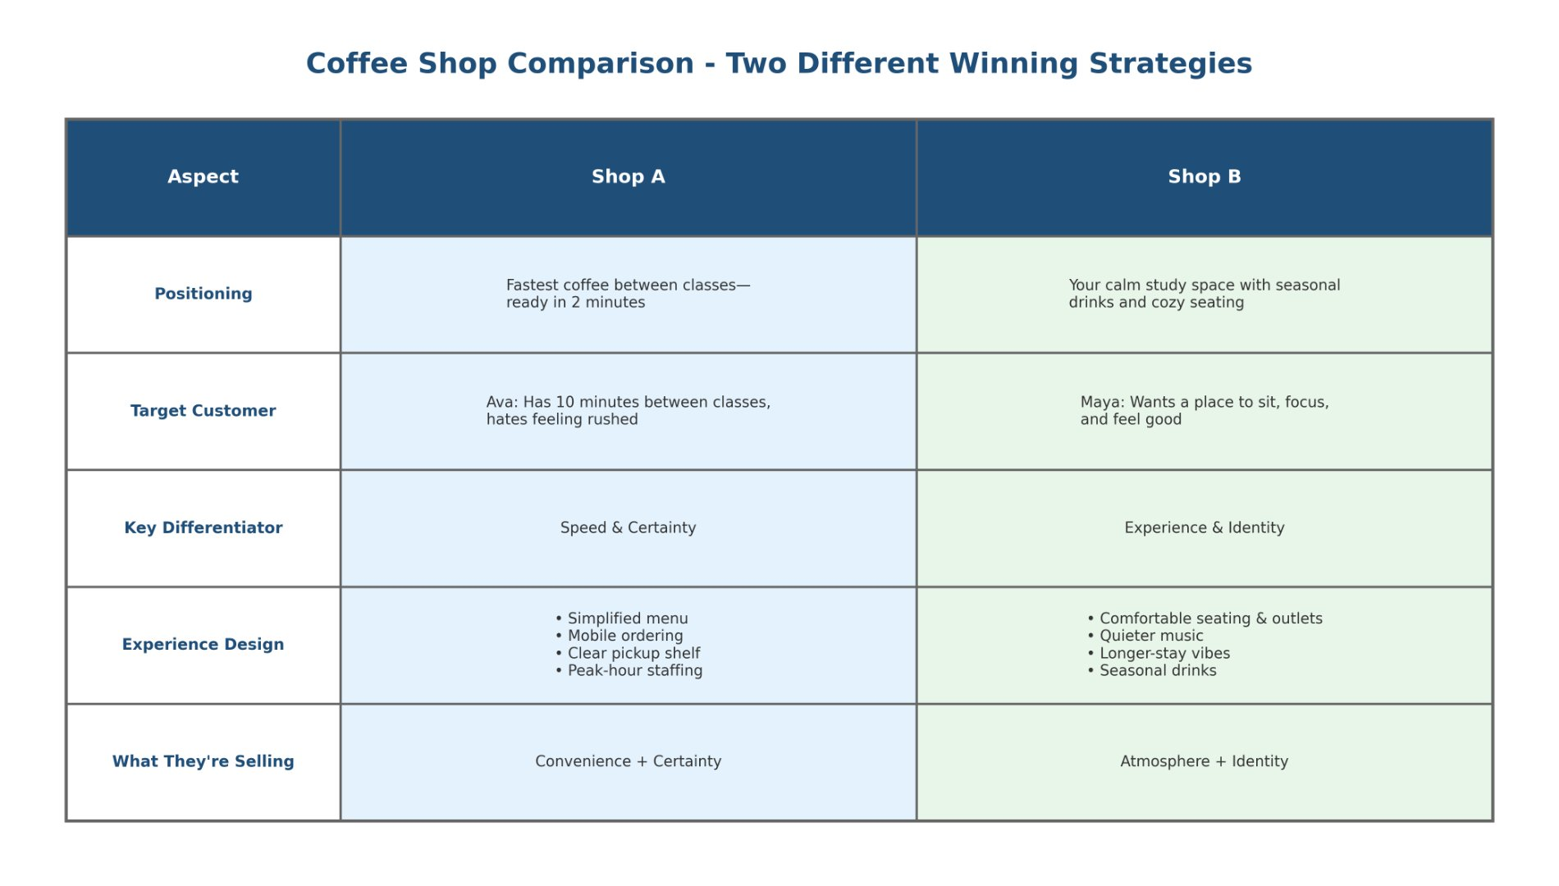

Coffee Shop Case Study
Two shops, two different strategies—both successful:
Strategic Trade-offs Visualization
Shop A: "The Fuel Stop"
Speed & Certainty
Focus: Convenience above all
Features: Mobile order-ahead, 2-minute pickup guarantee
Trade-off: Limited menu, standard assembly line, no seating
Shop B: "The Third Place"
Experience & Identity
Focus: Atmosphere and craft
Features: Artisan roasts, cozy seating, community events
Trade-off: Slower service, higher prices, wait times
Both succeed because they picked a clear lane.
Principles of Marketing • Module 4
7

Slide 8









Trade-offs Are Necessary
You can't be everything to everyone.
Strategic choices require sacrifice:
Strategy in Action
The Reality Check
Faster often means fewer customizations
The Impossible Claim
"We offer the highest quality products at the lowest market price with instant delivery."
Cheapest usually means fewer extras
VS
Luxury means slower, detailed experiences
Believable Positioning
"We aren't the cheapest option, but we guarantee 100% accuracy and white-glove service."
A believable strategy picks a lane—then proves it.
Principles of Marketing • Module 4
8

Slide 9

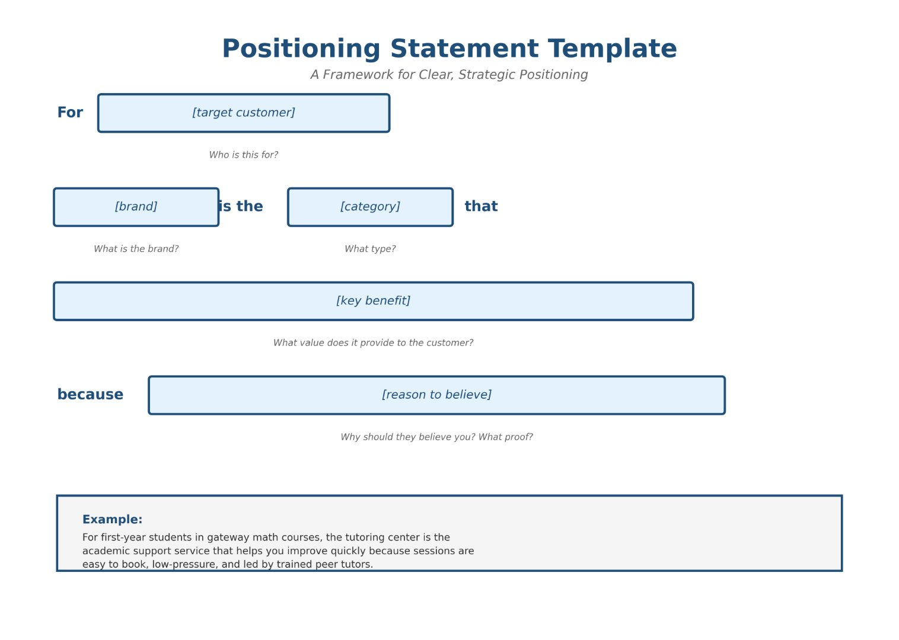


Positioning Statement Framework
A structured formula to articulate exactly how you want target customers to perceive your brand compared to competitors.
The Standard Formula
For , is the that because .
(target customer)
(brand)
(category)
(key benefit)
(reason to believe)
Example: Campus Tutors
"For first-year students in gateway courses, Campus Tutors is the on-campus tutoring center that provides quick, judgment-free help because sessions are led by trained peer tutors with proven results and easy online booking."
Principles of Marketing • Module 4
9

Slide 10


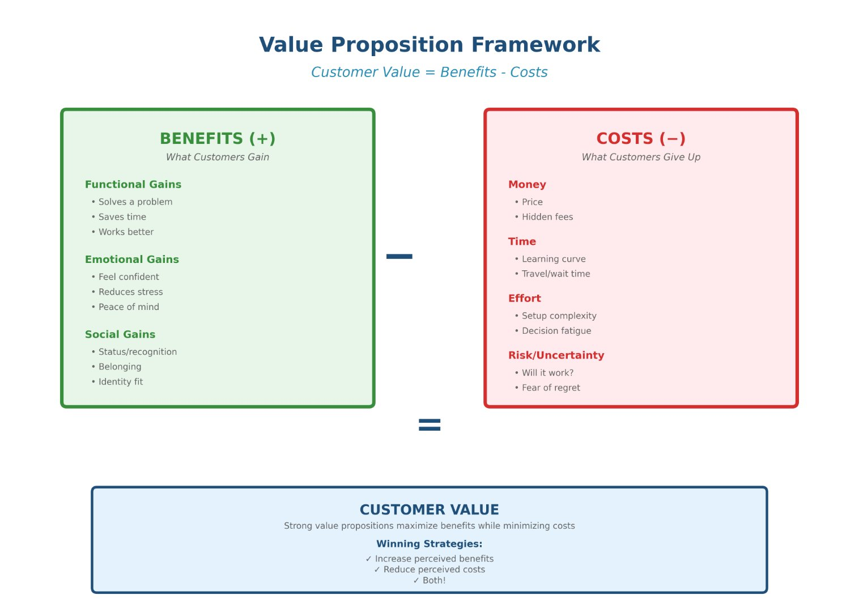



Value Proposition Formula
The Golden Rule
Customer Value =
Benefits − Costs
Components of the Equation:
Benefits (The Gains)Functional, emotional, and social value the customer receives.
Costs (The Pains)Money, time, effort, risk, and uncertainty involved in the purchase.
The StrategyStrong value propositions maximize benefits while aggressively minimizing costs.
Principles of Marketing • Module 4
10

Slide 11







Before & After — Tutoring Center
Weak Messaging
Strong Messaging
"Tutoring available for all subjects."
"Get unstuck fast on gateway courses—judgment-free, 30-minute sessions."
"Walk-ins welcome."
"Book in 60 seconds; trained peer tutors with 4.8/5 ratings. If you don’t improve, next session is free."
Problems: Vague, no proof, assumes I know I need help, ignores emotional barriers.
Solutions: Specific benefit, social proof, risk reversal, addresses 'embarrassment'.
Principles of Marketing • Module 4
11

Slide 12








Key Takeaways
Recap: Building a Fundable Brand
Positioning
The Bottom Line
Success
How customers understand you (Clear + Relevant)
Differentiation
Meaningful and believable with strategic trade-offs
A strong strategy isn't about being better at everything.
It's about being different in a way that matters to your specific customer.
Value Propositions
Specific, customer-centered (Benefits > Costs)
Proof Points
Build trust and reduce perceived risk
Principles of Marketing • Module 4
12

Slide 13








Positioning Matrix: Four Quadrants
Low Clarity + High Relevance
High Clarity + High Relevance
"Maybe... but I'm not sure."
"This is perfect for me."
Key Moves to Improve
They care about the problem, but are confused by your solution. Needs simpler language and clearer positioning.
Clear benefit, obvious fit. The customer understands immediately and wants it. Highest conversion rate.
Sharpen the Category Label: Make sure they know what it is instantly.
Confusing
Ideal State
Name the Target: Be specific about who it's for so they see themselves.
Low Clarity + Low Relevance
High Clarity + Low Relevance
Highlight 1-2 Benefits: Focus on the most meaningful outcomes, not just features.
"I don't get it, and I don't care."
"Okay... but not for me."
Misses both marks. Requires a complete rework of category, target customer, and core message.
People get it, but it doesn't solve their problem right now. You may be targeting the wrong customer.
Reason to Believe: Add distinct proof points to build trust and reduce risk.
Failed
Irrelevant
Principles of Marketing • Module 4
13

Slide 14






Five Key Differentiators
Convenience
Quality
Price / Value
Saves time or reduces effort for the customer.
Better performance, durability, or outcomes.
Feels worth the cost (lowest price or best deal).
Example
Example
Example
"Mobile order-ahead app with 2-minute pickup guarantee."
"Enterprise hosting with 99.9% uptime SLA."
"Bundle savings: Get 3 services for the price of 2."
Experience
Identity / Meaning
Smoother, more pleasant interactions.
Fits personal values or lifestyle choices.
Example
Example
"One-click checkout with no account required."
"100% ethically sourced ingredients from local farms."
Strategic Tip: Don't try to win on all five. Pick one primary lane to dominate, support it with 1-2 secondary elements, and match the industry standard on the rest.
Principles of Marketing • Module 4
14

Slide 15






Coffee Shop Strategies — Readable Comparison
Shop A: "The Fuel Stop"
Shop B: "The Third Place"
Strategy: Speed & Certainty
Strategy: Experience & Identity
Strategic Focus
Strategic Focus
Convenience above all else.
Atmosphere and craft quality.
Key Features
Key Features
Mobile order-ahead app, 2‑minute pickup guarantee, pre-set bundles.
Artisan roasts, cozy seating, community events, barista engagement.
Ideal Customer
Ideal Customer
Students rushing between classes; commuters.
Meetups, study sessions, coffee enthusiasts.
Necessary Trade-offs
Necessary Trade-offs
Smaller menu, no seating, standardized prep (less customization).
Slower service, higher prices, potential wait for tables.
Proof Points
Proof Points
Local roaster partnerships; event calendar; 4.8/5 vibe ratings.
On-time guarantee; average wait < 2 min.
Principles of Marketing • Module 4
15

Slide 16




Positioning Statement Framework
The Formula
For , is the that because .
key benefit
target customer
brand
category
reason to believe
1
Target Customer
Who exactly? (first-year students in gateway courses)
Example: Campus Tutors
2
Category
What are you? (on-campus tutoring center)
3
Key Benefit
"For first-year students in gateway courses, Campus Tutors is the on-campus tutoring center that provides quick, judgment-free help because sessions are led by trained peer tutors with proven results and easy online booking."
What outcome? (quick, judgment-free help)
4
Reason to Believe
Why trust you? (trained peer tutors, proven results)
Principles of Marketing • Module 4
16

Slide 17








Value Proposition — Benefits and Costs
Benefits (+)
Costs (-)
The Gains customers receive
The Pains customers give up
Functional
Money
Saves time, delivers better results, reduces errors, improves efficiency.
List price, subscription costs, hidden add-on fees.
Emotional
Time
Feels confident, reduces stress, provides peace of mind, enjoyment.
Setup time, learning curve, wait times, installation delay.
Social
Effort
Sense of belonging, recognition, status, identity alignment.
Switching vendors, data entry, physical effort, coordination.
Access / Convenience
Risk / Uncertainty
Faster onboarding, easy booking, 24/7 availability, self-service.
"Will it work?", fear of regret, privacy concerns, security risks.
Strategy: Maximize key benefits while actively reducing the biggest cost barriers.
Principles of Marketing • Module 4
17

Slide 18









Tutoring Center Messaging Transformation
Before: Generic & Risky
After: Specific & Credible
Vague Offer
Clear Benefit
"Tutoring available for all subjects."
(Doesn't specify who it's for or the outcome)
"Get unstuck fast on gateway courses."
(Specific outcome for specific courses)
Ignores Emotional Barriers
Risk Reduction
Does not address embarrassment ("Walk-ins welcome" feels exposed) or fear of judgment.
"Judgment-free, 30-minute sessions."
(Removes embarrassment and defines time commitment)
No Time Clarity
Easy Process
Unclear commitment. Students worry it will take hours or be inefficient.
"Book in 60 seconds."
(Removes friction and effort barrier)
No Proof of Effectiveness
Strong Proof Points
No evidence that it actually works, leaving high uncertainty/risk.
"Trained peer tutors with 4.8/5 ratings. If you don't improve, next session is free." (Social proof + Guarantee)
Principles of Marketing • Module 4
18

